Slide 1
Overview of HIV
Including HIV Epidemiology in Louisiana
Presented by: Dr. Sam Burgess
Louisiana Department of Health
September 2023

Slide 2

What is HIV?
HIV
Human Immunodeficency Virus
  H: stands for human. It’s transferred from human to human contact only.
  I: stands for immunodeficiency. This means that our immune system is not working as well as it should.
  V: stands for virus. This is a particular virus that targets and fights our white blood cells.
As the body loses white blood cells it becomes harder for our body to fight infection & disease.
AIDS
Acquired Immune Deficiency Syndrome
AIDS is a syndrome.
Patients do not die from HIV or AIDS, but from opportunistic infections, commonly Tuberculosis or pneumonia.

Slide 3
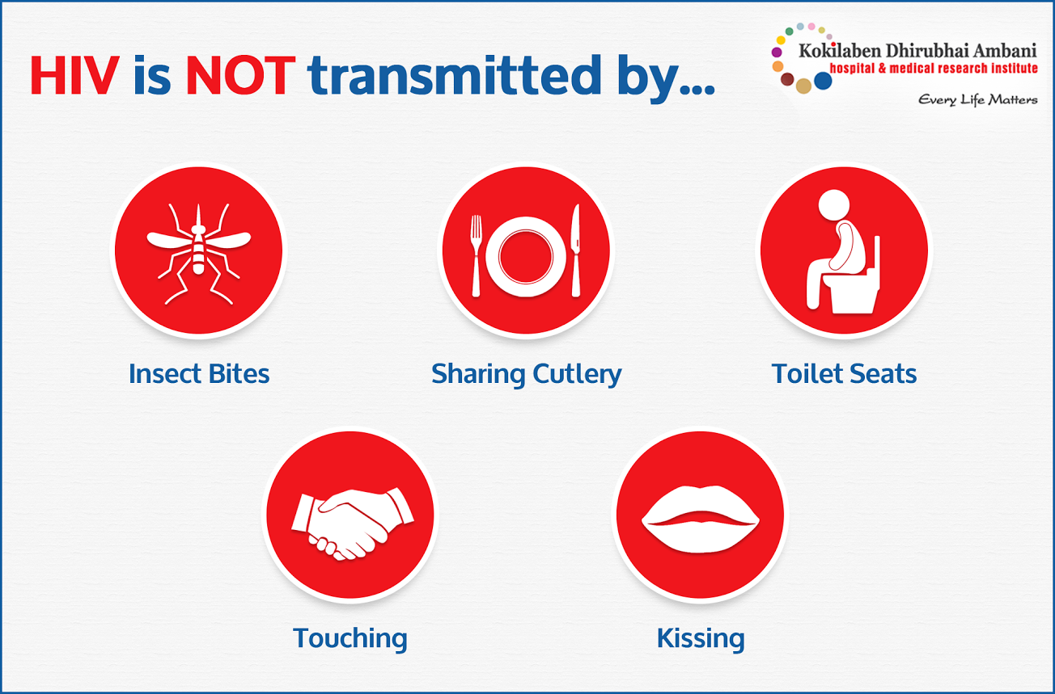
The 4 Fluids that Transmit HIV
BLOOD
SEMEN
VAGINAL FLUID
BREAST MILK
Notes:
HIV fluids

Slide 4
Transmission Routes
Notes:
Sharing needles & the works put you in direct contact with other people’s blood. Needles that are contaminated with HIV-infected blood can deliver the HIV virus directly into your bloodstream.
Pregnancy & childbirth: Babies have constant contact with their mother/parent’s body fluids.
During pregnancy babies can become infected through blood and amniotic fluid.
Just as with sex, there is a lot of friction during childbirth & HIV can be passed through the exchange of blood & vaginal fluids.
Breast milk: A mother/parent can infect a child through their breast milk.
Blood transfusions & organ transplants: Screening requirements makes these forms of HIV transmission very rare in the United States.

Slide 5
Estimated Per-Act Probability of Acquiring HIV (when source of exposure has HIV)
Type of Exposure | Risk per 10,000 Exposures
Exposure Through Needles:
Blood Transfusion | 9,250
Needle-Sharing During Injection Drug Use | 63 (1 out of 159 exposures)
Percutaneous (Needle-Stick) | 23 (1 out of 435 exposures)
Sexual Exposures:
Receptive Anal Intercourse | 138 (1 out of 73 exposures)
Insertive Anal Intercourse | 11 (1 out of 909)
Receptive Penile-Vaginal Intercourse | 8 (1 out of 1,250)
Insertive Penile-Vaginal Intercourse | 4 (1 out of 2,500)
Receptive Oral Intercourse | Low
Insertive Oral Intercourse | Low
Source: https://www.cdc.gov/hiv/risk/estimates/riskbehaviors.html

Slide 6

Pre-Exposure Prophylaxis (PrEP)
PrEP is a medication that utilizes ARVs to prevent HIV infection in people who are not living with HIV.
When a person taking PrEP is exposed to HIV, the medication blocks the virus from making copies of itself and prevents them from becoming infected.
PrEP does not protect against other STIs or pregnancy.
PrEP can reduce the risk of getting HIV by as much as 99%
Notes:
The pill that was shown to be safe and to help block HIV infection is called “Truvada” (pronounced tru vá duh). Truvada is a combination of two drugs (tenofovir and emtricitabine).
If you take PrEP daily, the presence of the medicine in your bloodstream can often stop HIV from taking hold and spreading in your body. If you do not take PrEP every day, there may not be enough medicine in your bloodstream to block the virus.
CDC recommends that PrEP be considered for people who are HIV-negative and at substantial risk for HIV.
For sexual transmission, this includes anyone who is in an ongoing relationship with an HIV-positive partner. It also includes anyone who
1) is not in a mutually monogamous* relationship with a partner who recently tested HIV-negative, and
2) is a gay or bisexual man who has had anal sex without a condom or been diagnosed with an STD in the past 6 months; or
Heterosexual man or woman who does not regularly use condoms during sex with partners of unknown HIV status who are at substantial risk of HIV infection (e.g., people who inject drugs or have bisexual male partners).
For people who inject drugs, this includes those who have injected illicit drugs in the past 6 months and who have shared injection equipment or been in drug treatment for injection drug use in the past 6 months.
People who use PrEP must be able to take the drug every day and to return to their health care provider every 3 months for a repeat HIV test, prescription refills, and follow-up.
*http://www.cdc.gov/hiv/basics/prep.html

Slide 7
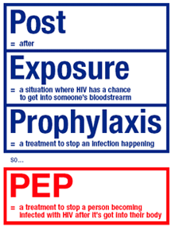
Post-Exposure Prophylaxis (PEP)
PEP involves taking anti-HIV drugs within 72 hours after a potential exposure to HIV.
1-2 pills per day for 28 days.
When should someone take PEP?
  Workplace sharps exposure
  After sexual assault
  Unprotected sex
  Needle sharing
PEP should only be used in emergency situations. It is not a substitute for PrEP or other risk reduction methods.
Notes:
SIDE EFFECTS: PEP is safe but may cause side effects like nausea in some people. These side effects can be treated and are not life-threatening.
Where to get PEP: Some of the places you can go to seek treatment include your doctor’s office, emergency rooms, urgent care clinics, or a local HIV clinic.
How to pay: If you are a health care worker who was exposed to HIV on the job, your workplace health insurance or workers’ compensation will usually pay for PEP.
If you are prescribed PEP after sexual assault, you may qualify for partial or total reimbursement for medicines and clinical care costs through the Office for Victims of Crime, funded by the US Department of Justice.
If you are prescribed PEP for another reason, and you cannot get insurance coverage (e.g., Medicaid, Medicare, private, or employer-based), your health care provider can apply for free antiretroviral medicines through the medication assistance programs run by the manufacturers. Online applications can be faxed to the company, or some companies have special phone lines. These can be handled urgently in many cases to avoid delay in getting medicine.
*http://www.cdc.gov/hiv/basics/pep.html

Slide 8
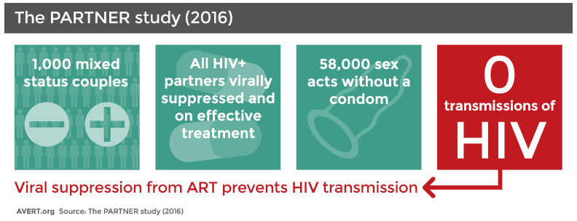
Undetectable=Untransmittable
When a person undergoing HIV treatment reaches viral suppression, their viral load (amount of HIV in the body) becomes very low and is considered undetectable.
U=U or UNDETECTABLE = UNTRANSMITTABLE
SDOH : Access to healthcare, housing and other environmental factors impact a person’s ability to remain engaged in HIV medical care to achieve/maintain viral suppression.
Notes:
An undetectable viral load means the levels of HIV in the blood are so low they can’t be detected by standard tests.
Explain the importance of getting clients linked to care, adhering to medication in order to reduce viral load and thus being less likely to pass along HIV from one person to another.

Slide 9
The current picture of HIV in Louisiana

Slide 10
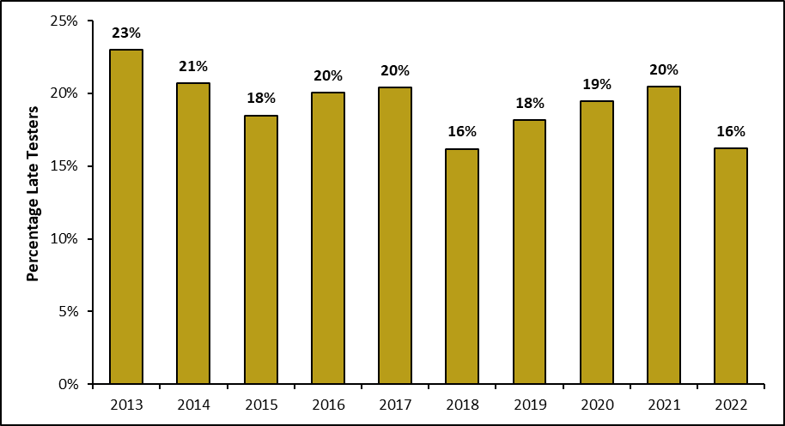
Late Testers among People Newly Diagnosed with HIV
Louisiana, 2013-2022
Late tester defined a person meeting the AIDS case definition within 30 days of initial HIV diagnosis.

Slide 11
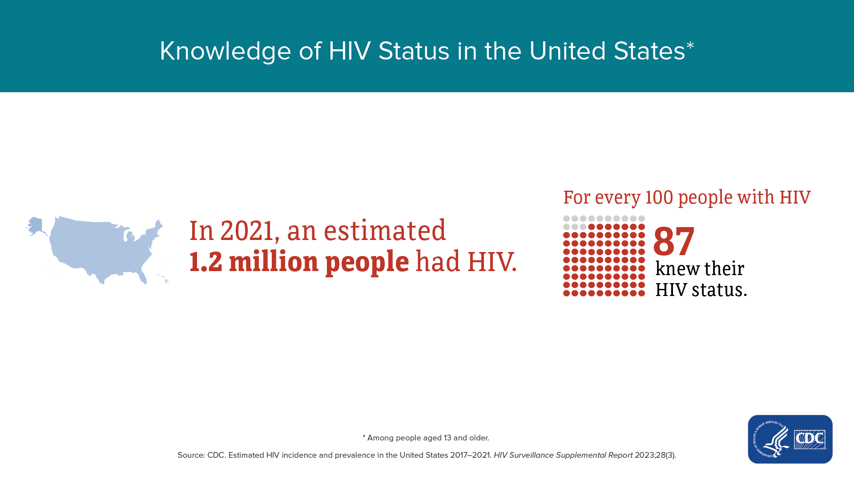
In Louisiana, only 84.4% of persons living with HIV are aware of their diagnosis
(~4000 people living with undiagnosed HIV in Louisiana).

Slide 12
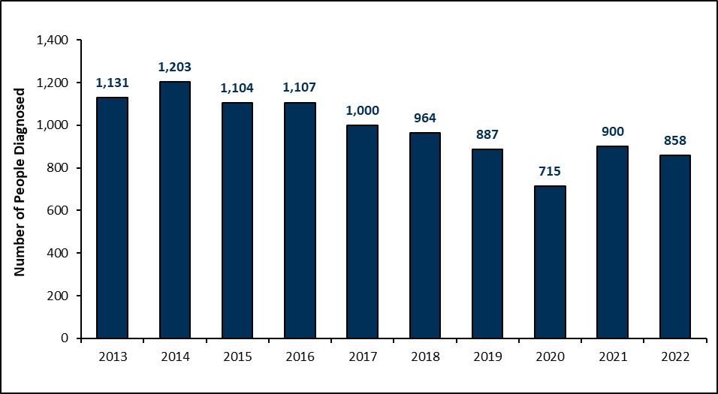
Number of People Newly Diagnosed with HIV
Louisiana, 2013-2022
COVID-19

Slide 13
People Newly Diagnosed with HIV
By Public Health Region, 2022
*Rate per 100,000

Slide 14
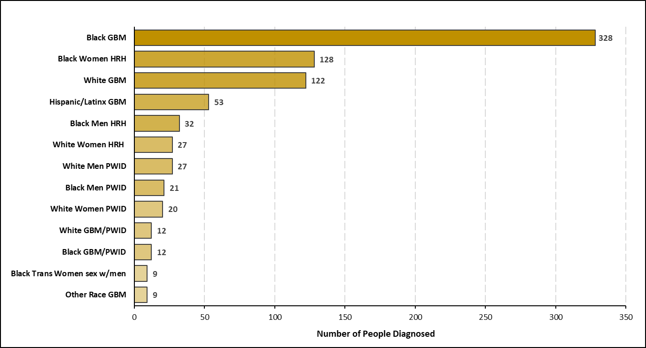
People Newly Diagnosed with HIV by Race/Gender/Risk
Louisiana, 2022
Subgroups <9 not shown. GBM: Gay, bisexual, & other men who have sex with men. HRH: High risk heterosexual. PWID: Person who inject drugs.

Slide 15
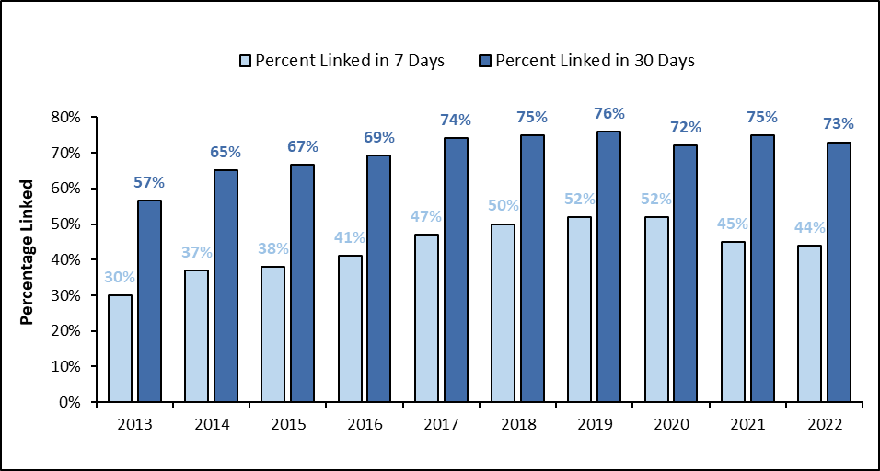
Linkage to Care among People Newly Diagnosed with HIV
Louisiana, 2013-2022
Linkage to care defined as the first CD4 or viral load lab collected on or after date of HIV diagnosis.

Slide 16
Linkage to Care among People Newly Diagnosed with HIV
By Public Health Region, 2022
Linkage to care defined as the first CD4 or viral load lab collected on or after date of HIV diagnosis.

Slide 17
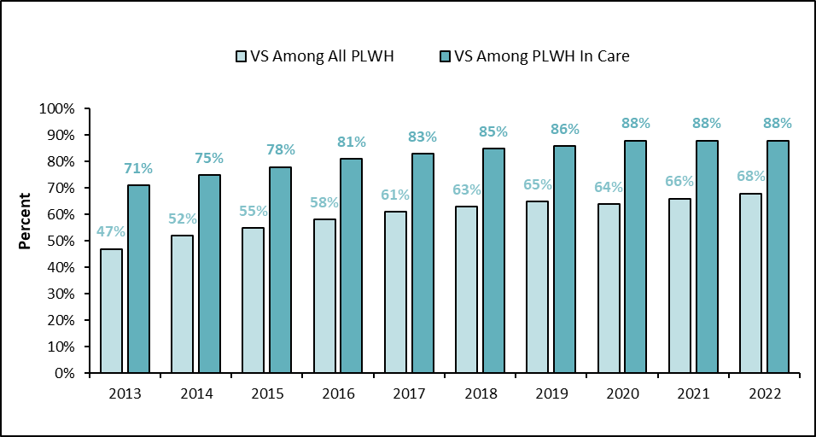
Viral Suppression (VS) among People Living with HIV
Louisiana, 2013-2022
Viral suppression is a count < 200 copies/mL. In HIV care is defined as having at least one CD4 or viral load during the measurement year.

Slide 18
Viral Suppression (VS) among People Living with HIV
By Public Health Region, 2022
Viral suppression is a count < 200 copies/mL. In HIV care is defined as having at least one CD4 or viral load during the measurement year.

Slide 19

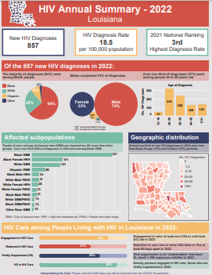
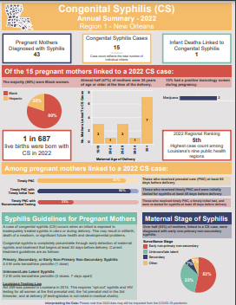
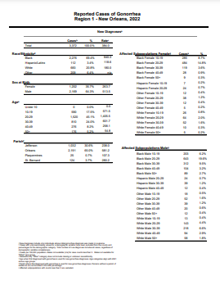
HIV/STI/Hepatitis Data Resources
https://www.louisianahealthhub.org/data-reporting/

Slide 20
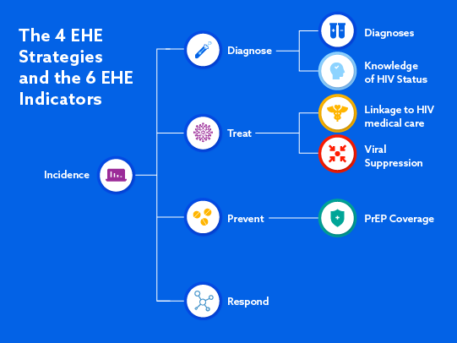
Ending the HIV Epidemic (EHE)

Slide 21
Acknowledgments
Thank you to the following staff for developing this presentation:
Lauren Ostrenga & Jessica Fridge (SHHP Surveillance Supervisor and Manager)
Kelley Anderson (SHHP Capacity Building Supervisor)

