Slide 1

Quality Management
Louisiana Department of Health - Office of Public Health
STD/HIV Program (SHP)
Diona Walker, Services Quality Manager

Slide 2
Outcomes
Understand basic definition of Quality Improvement
Understand HRSA/HAB grant requirements (PCN #15-02)
Develop a common knowledge and framework of QI principles
Understand QM Service Standards
Share QM resources to support your agency QI efforts and meet requirements

Slide 3
What is Quality Improvement?
is an organizational approach
is a team based, problem solving approach
uses a specified set of principles and methodologies
IMPROVES CARE!
Notes:
Quality Improvement is one the components of an effective CQM Program

Slide 4
Quality Improvement vs
Quality Assurance
Quality Assurance
Uses an identified set of standards/metrics to review performance and monitor processes i.e., utilization review, risk management, infection control, credentialing, accreditation and etc…
Quality Improvement
Process of collecting and using valid data to:
Understand the current level of quality
Identify gaps between actual quality and expected quality for that setting
Introduce changes in the care system (affecting inputs and processes of care)
Frequently measuring the effect of those changes on health outcomes and system performance
Notes:
QA defines measures and monitors performance, it refers to a broad spectrum of activities (site visits & chart reviews) aimed at ensuring compliance and
QI uses the measures to plan and test improvements
-Combined they move us toward systemic change and lead us to a Culture of Quality!

Slide 5
Quality Management Expectations for Ryan White Recipients
(everything you need to know about PCN # 15-02)
What is PCN?
Policy Clarification Notice
Reference documents:
  PCN #15-02 Clinical Quality Management Policy Clarification Notice
  FAQs: Clinical Quality Management Policy Clarification Notice (Released 12/01/2015)
Notes:
SHP as recipients of the grant are governed by PCN’s and national monitoring standards, and QM specifically by PCN #15-02. The CQM PCN specifically identifies the specific expectations of a quality program for Ryan White programs. The PCN’s and National Monitoring Standards inform the expectations of the subrecipients.

Slide 6
RWHAP Expectations
(PCN #15-02)
RWHAP Parts A-D are required to establish a clinical quality management (CQM) program to ensure grant- funded services are consistent with the most recent Health and Human Services (HHS) guidelines for the treatment of HIV and related Opportunistic Infections (OIs)
Implement strategies to improve the access to and quality of HIV services
CQM is a major component that HRSA/HAB supports to optimize health outcomes and reduce HIV incidence
Services Quality Manager’s responsibility to work with sub recipients to implement, monitor and provide needed data on the CQM program
Includes all services, including clinical and support services
Notes:
It is SHP’s responsibility to work with sub recipients i.e. you all, to implement, monitor and support a quality management program
I would encourage coordination of CQM activities across other RWHAP sub recipients within a service area with the aim of:
-Reducing the data burden
-Alignment of performance measurements and
- Maximizing the impact of improved health outcomes

Slide 7
PCN #15-02:
Components of an effective
QM Program
Infrastructure
Performance Measurement &
Quality Improvement
Notes:
All of which I am here to assist. My role is to help frame, enhance and/or support your QM Program. I understand that there may be varying degrees of your agencies current needs and this will all be considered when working with you all individually.

Slide 8
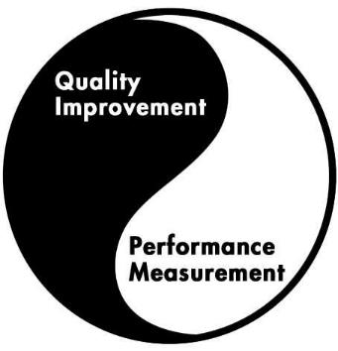
Infrastructure
Principle:
Infrastructure enhances systematic implementation of improvement activities
Infrastructure
Notes:
Infrastructure supports measurement and improvement

Slide 9




PCN#15-02
Components of
Quality Infrastructure
Leadership
Quality Committee
Quality Plan
Dedicated Staffing (and delineated roles)

Slide 10




Infrastructure Components cont’d…
Dedicated Resources
Consumer Involvement
Stakeholder Involvement
Evaluation

Slide 11
Performance
Measurement
Principle:
“Actions are based on
ACCURATE and MEASURABLE data”
You can’t improve what you can’t measure
Notes:
In order to do QI work, we MUST collect data to really show what’s going on…

Slide 12

Performance
Measurement
(PCN#15-02)
A sound QI Program reflects
RWHAP funded services
Local Epidemiology &
Identified needs of PLWH
Strongly encouraged to include HAB (HIV/AIDS Bureau)
and (Health and Human Services) HHS measures that align with (National HIV/AIDS Strategy) NHAS

Slide 13
Performance Measurement
(PCN #15-02)
Identified process to regularly collect and analyze performance measurement data (should occur quarterly per PCN) - Kristina Larson
ALL RWHAP- funded services categories must have at least one performance measure; highly utilized & highly prioritized service categories should identify two performance measures.
Notes:
PMs can be represented by single units (hours, dollars, number of clients, length of time and etc…) or multidimensional units (number of clients accessing care vs. all clients)
There are benchmarks, that will be shared and they will be in the final version of your contracts. Moving forward I’d like to set up a call with our Data Analyst here to go over the benchmarks. Kristina provides factsheets and we will look at the benchmarks for support services in a similar fashion.

Slide 14
Performance
Measurement
Types of Measures
Process Measures are the voice of the system.
Process measures tell us whether parts or steps in the system are working as planned.
Ex. Waiting time for appointments, no show rates, % of clients with self management goals in place, number of clients organized by acuity level in case management, length of time to complete LA HAP applications or LA HAP recertification rates.
Outcome Measures are the voice of the customer.
Outcome measures reflect the impact of our work on the care provided to our clients.
Ex. Incidence of disease rates, mortality & morbidity rates, client/case manager satisfaction rates or cost of care delivered

Slide 15
Quality Improvement
Principle:
“Success is achieved through meeting the needs of those we serve”
Notes:
Consumers are the ultimate recipients of care and quality improvement need to address their needs. Most problems are found in processes, not in people.

Slide 16
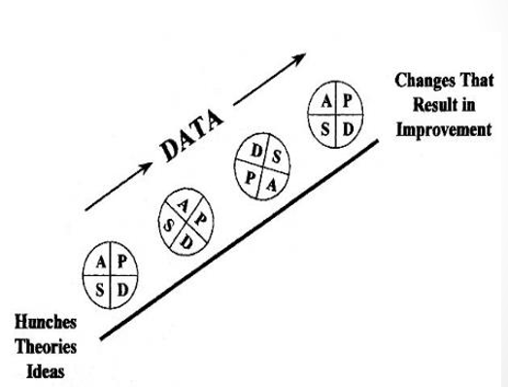
Quality Improvement
Achieve continual improvement through small, incremental changes
Notes:
Develop solutions in teams. Group discussion yield better results than a single person, multidisciplinary teams should be considered.
Example- idea (implement new 30 day follow up requirement for open/outstanding referrals) maybe you just test this with one case manager, changes that result in improvement (decrease the percent of open/outstanding referrals to external agencies)

Slide 17
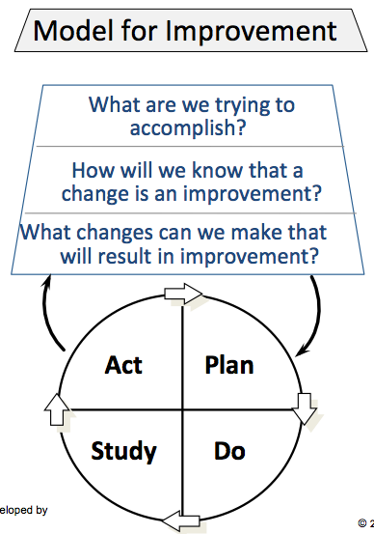
Quality Improvement
Notes:
According to PCN#15-02, recipients should be conducting a QI project for at least one service category at any given time.

Slide 18
Quality Improvement
(PCN #15-02)
The goal is to:
Improve patient/client access
Patient/client care(services)
Health outcomes &
Patient/client satisfaction
Notes:
In order to accomplish these goals, QI must ne implemented in an organized, systemic fashion

Slide 19
Service Standards
2. Standard
2.1 Agencies must participate in one QI project per year that
addresses improvement in service quality and delivery
Measure
Quarterly reports submitted of the performance measures pertaining to the QI project
2.2 Agency must have Quality Management plan updated biannually and approved by SHP Quality Management Staff, to include the required yearly QI project
Measure
Submission of Quality Management plan to the Services Quality Manager within first 30 days of the new contract

Slide 20
Service Standards
2.3 Agency must conduct a Client Satisfaction Survey annually, survey must be approved by SHP Quality Management Staff, to obtain input from clients in the design and delivery of services
Measure
Documentation of content, use and confidentiality of the Client Satisfaction Survey
2.4 Agency must structure an ongoing Consumer Advisory Board (CAB) or the existence of an ongoing suggestion box for client input
Measure
Documentation of CAB meetings ,to include: meeting minutes, sign in sheets and meeting agenda
Documentation of content, use and confidentiality of the suggestion box

Slide 21
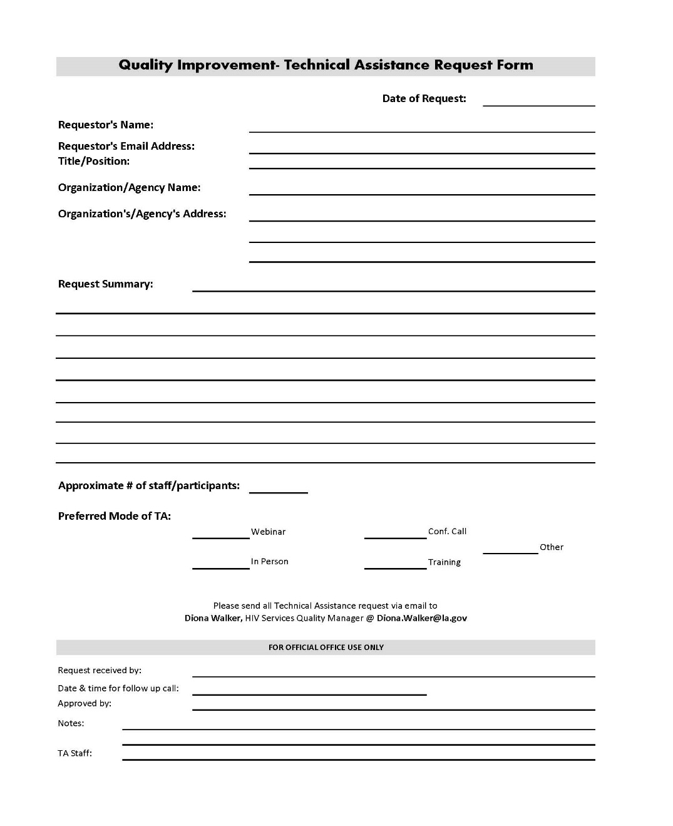
Technical Assistance Request
Form

Slide 22
Next Steps
Rough Draft of QM plan submitted within first 30 days of new contract
Provide Diona Walker with agency QM contact person’s
(Name, Contact # and Email)
Quarterly Calls, duration: 1.5 hours
Changes implemented September 1, 2018

Slide 23
In 2018, you can expect
Accountability
QI quarterly conference calls
Submission of data quarterly
Greater emphasis on agency QM programs during site visits

Slide 24
Resources
Quality Academy: Quality Improvement for Non-Clinical Services
https://targethiv.org/library/quality-academy-quality-improvement-non-clinical-services
NQC Tutorials:
www.nationalqualitycenter.org
Series of QI learning modules
Beginner to advanced

Slide 25
Contact Information
Diona Walker
HIV Services Quality Manager
Office #: 504-568-7474
Email: Diona.Walker@la.gov

Slide 26

Questions?

