Slide 1

Quality Management 101 Series
Module 4
QI Project Steps and PDSA
Nanette Brey Magnani, EdD, National QI Consultant
Diona Walker, MSP, Services Quality Manager
Hosted by: Louisiana Department of Health HIV/STD Program sted by: Louisiana Department of Health-STD/HIV Program

Slide 2


Slide 3
Opening Remarks

Slide 4

QM 101 Series
Module 1: Overview - Quality Improvement
    April 11, 2018; 12:00 pm – 1:00 pm
Module 2: Quality Program Infrastructure
    May 9, 2018; 12:00 pm – 1:00 pm
Module 3: Performance Improvement
    June 6, 2018; 12:00 pm – 1:00 pm
Module 4: QI Project Steps and PDSA
    July 11, 2018; 12:00 pm – 1:00 pm

Slide 5

July 25^{h}; 12-1
Infrastructure

Slide 6

First Things, First…
Your Name
Your Department
Your Role
What question or issue do you have for the group discussion?

Slide 7
Quality Improvement (Module 4)
HAB PCN#15-02.
The goal is to improve patient access, patient care, health outcomes & patient satisfaction
Should be implemented in an organized, systemic fashion
Should use a defined methodology, e.g., IHI’s model for improvement, Lean, etc.
Must be documented – “If it wasn’t documented, …”
Per the FAQs, recipient should be conducting a QI project for at least one service category at any given time.

Slide 8
Principles of
Quality Improvement

Slide 9

What is Quality Improvement?
Quality improvement
  is an organizational approach
  is a team-based, problem solving approach
  uses a specified set of principles and methodologies
  improves care
Notes:
keep

Slide 10
Fundamental Concept
“Every system is perfectly designed to achieve exactly the results it achieves.”
Paul Batalden, MD, IHI Senior Fellow
Notes:
keep

Slide 11
Why we Focus on Processes
A system is made up of processes
“Each process is perfectly designed to get the results it achieves”
Getting a better result therefore requires re-designing the process
Quality Principles
Notes:
Processes will do what they’re designed to do. Urging your appointment clerk to work harder in a patient referral process where he or she has six other assignments, half of which take him or her away from the workstation with access to the appointment system, does no good. Somehow, we have to make it easier for patients with referrals to set up time for their appointments. The way to do this is by changing the process, the way work is done.

Slide 12
Guiding Principles of Improvement and QI Tools
Examples
Understand work in terms of processes and systems | Work flow diagrams Causal analysis tools
Develop solutions by teams | Care teams Multidisciplinary teams PDSAs Ever Better Board
Focus on patient needs – patient centered care | Performance measurement results Patient satisfaction surveys Focus groups Morning huddles
Test and measure effects of changes | Measures and results: Process, Outcome Quality Data reports
Notes:
keep

Slide 13

QI Project Team Management

Slide 14

QI Project Team: What is your role on your team?

Slide 15
QI Project Team Management
Start with the team
  Use your QI Project planning format
  Identify your staff that could be involved with the area of process for improvement.
Establish roles and ground rules – can be as basic as identifying a regular meeting time, a recorder and a team leader.

Slide 16
Improvement Project Framework: DMAIC
An approach to problem solving that uses a scientific methodology
  Define the scope and purpose of a project
  Measure by collecting data (performance measure results, patient feedback, staff feedback)
  Analyze the data and determine root causes
  Improve by developing “fixes” for the root cause
  Control by tracking performance indicators

Slide 17
Problem Solving: Enhanced PDSA: “A3”
Enhanced
PDSA
Problem Definition
Countermeasures
PLAN
+
Plan
DO
ACT
Root Cause(s)
STUDY
(or Check)
Results
Enhances “Plan” in PDSA with better understanding of the problem
and causes, to generate better countermeasures
Center for Innovation and Transformational Change, UMass Memorial Health Care University of Massachusetts Medical School, slides 7-10, 14
Notes:
You can think of the A3 as your “standard work” for problem solving, whether it’s removing waste in your department, or working one of the Action Items from a VSM.
At Toyota, managers / approvers don’t say “No”. They either say “Yes”, or they ask more questions – about the problem, root cause, options….

Slide 18
Louisiana Statewide QM Group
QI Project Storyboard Template

Slide 19
Title
Agency
Team Leader Name
Team Members

Slide 20
QI Project Background
Describe the rationale and scope of the QI Project for selecting project. Why is this important to improve? What is the range to be explored? What are the key processes?
Example: Viral load suppression is a key indicator of HIV healthcare, and the clinic’s viral load suppression rate is lower than the statewide mean. The team is testing an intervention with a sub population of patients not suppressed during August, 2017 – December 2017.

Slide 21
Measure(s)
Describe performance measure and results
Measure: You can cut and paste the next slide here. This VL suppression measure is an example of an Outcome Measure. Or, if you choose a different QI initiative, write your measure here, i.e., gap in care, cervical cancer screening, oral health exam.

Slide 22
Example: Viral Suppression Measure
Performance Measure
Percentage of patients, regardless of age, with a diagnosis of HIV with a HIV viral load less than 200 copies/ml at last HIV viral load test during the measurement year
  Numerator: Number of patients in the denominator with a HIV viral load less than 200 copies/mL at last HIV viral load test during the measurement year
  Denominator: Number of patients, regardless of age, with a diagnosis of HIV with at least one medical visit in the measurement year
Patient Exclusions: None

Slide 23
Baseline Data
Present your baseline data in terms of percent and actual numbers.
____% n=____
e.g. percentage (75%) of patients whose VL was suppressed for the entire measurement period and actual number (75 of 100 patients)

Slide 24
Improvement Project Goal (s)
Example: Measureable goal or aim.
  To increase the number of patients with suppressed viral loads from 75% to 85% by the end of December 31, 2017.

Slide 25

AIM Statement
Clearly state the team’s improvement
Aim or Goal.
  SMART objectives criteria
    Specific – who, what, one action verb
    Measurable – how much; quantify the amount to
    be changed in order to know when the
    objective is met
    Achievable vs stretch – within timeframe and
    resources
    Realistic – doable and relate to the scope of the
    problem
    Time – provide a time frame

Slide 26

Step 2: Write an Improvement Goal
Tips for Setting Aims (Improvement Goals/Objectives)
  State the aim clearly
  Teams make better progress when they are very specific about their aims. Make sure that the aim statement describes the system to be improved, the patient population and the approach to improvement.
  Include numerical goals that require fundamental change to the system
  Setting numerical goals clarifies the aim, helps to create tension for change, directs measurement, and focuses initial changes.
  Set stretch goals
  A "stretch" goal is one to reach for within a certain time. Effective leaders make it clear that the goal cannot be met by tweaking the existing system.
  Avoid AIM drift
  Once the aim has been set, the team needs to be careful not to back away from it deliberately or "drift" away from it unconsciously.
  Be prepared to refocus the aim
  Every team needs to recognize when refocus its aim. Don’t confuse aim drift, or backing away from a stretch goal (usually not a good tactic), with consciously deciding to work on a smaller part ofthe system (often is a good tactic).
  Source: Institute for Healthcare Improvement
Notes:
26

Slide 27
Writing an Improvement Goal Statement (example)
Format
This is important to improve because__________ (the rationale or business case: it is a strategic goal, it is a safety concern, causes delays for patients or clinicians, is not effective, is not efficient, is not equitable, is not patient-centered, affects the staff, etc.)
Example
The aim of this project is to increase the percent of our diabetic patients that received an eye exam from 80% to 100% during the period, January 1 – June 30, 2009. The process begins when patients schedule an appointment and ends when the patient completes the exam.
This is important to improve because it aligns with our strategic goal to improve the care of diabetic patients.
Adapted from: Univ ot Texas. MD Anderson Cancer Center
Notes:
27

Slide 28
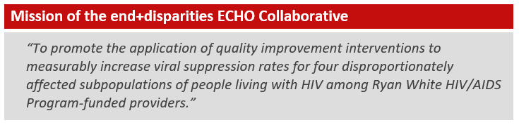
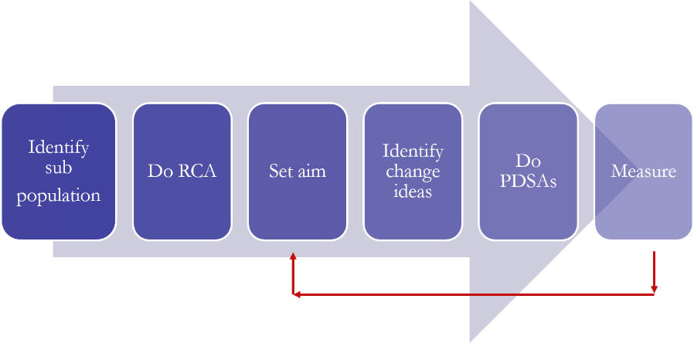

Slide 29
Analyze the Process and Root Cause Analysis
Share the root causes of the problem and describe the tool you used.
  Example:
    Results of drilled down patient level data –
      Patients not adhering to meds (25)
      Patients not picking up meds (15)
      Patients low levels of health literacy (45)
      Transportation (5)
      Substance use (10)
      Mental health (12)
    Verification of key causes
      Multidisciplinary team members identified key causes for each patient and then tallied the number.
      Our clinic is located in one of the highest illiteracy rates in LA.
      Random check in with X number of patients, X percent did not know what their VL was and why it was important.

Slide 30
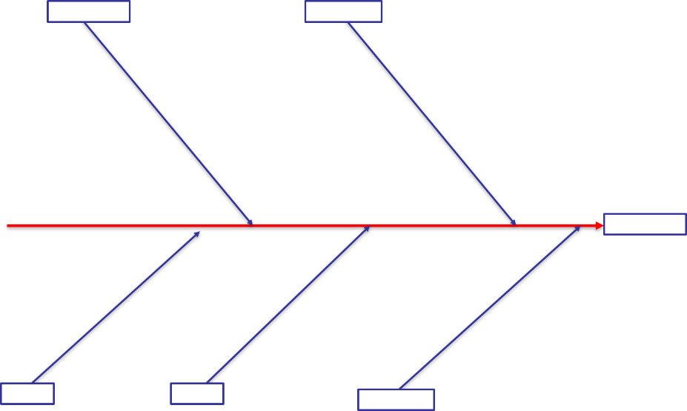
Root Cause Analysis of:

Slide 31
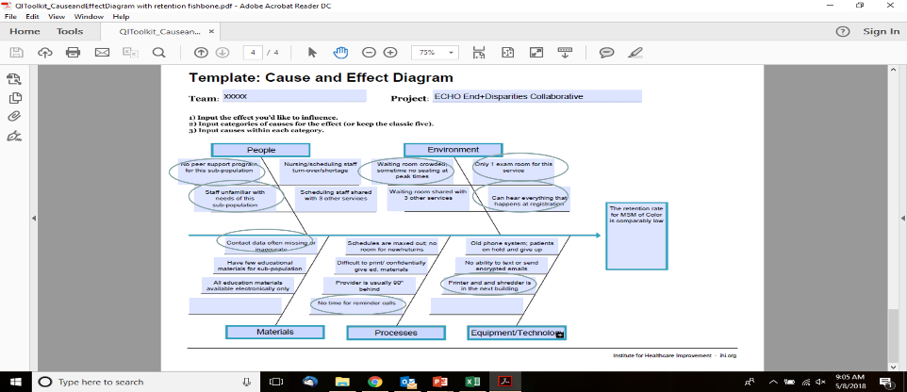
Key Causes
Notes:
Using your cause/effect diagram (fishbone), list the top 5 reasons that lead to “detectable viral load in sub-population”]
OR
[Insert cause/effect diagram with the top 5 reasons circled here]

Slide 32
RCA: Flowchart
Is the process being run the way it should be?
Are people following the process as charted?
What are the root causes of bottlenecks, non-sequiturs, complexities, or redundancies?
What are the materials, equipment, information, personnel etc. that drive the process forward? What things are restraints?
Actual vs. Future State
Draw a Future State Flowchart, this maps the improved process.
Compare future state to current state (actual).
What are the discrepancies?
What can be improved?

Slide 33
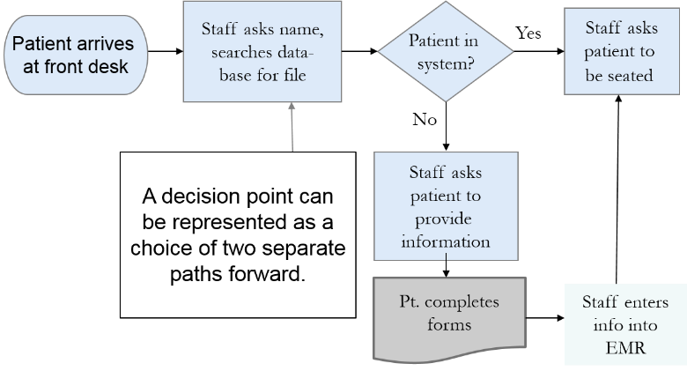
The Diamond: Decision Point
The diamond is used anytime a choice is necessary to move the process forward.
Notes:
Uneven flowchart symbol sizes: When possible, make all your flowchart symbols the same height and width.
Uneven spacing between flowchart symbols: Try to maintain even spacing both horizontally and vertically between symbols. The one exception should be for Decision symbols. You should add extra spacing around these to accommodate branch labels.
Wrong Flow Symbols = use the correct shape of the symbols for their given action.

Slide 34

Crescent Care Start Initiative: Dr. Jason Halperin
Patient confirmed positive
PN contacted by cellphone. DOB, First and last name, Phone number, DX date
Appointment scheduled with provider, labs, eligibility.
DIS called to verify that the patient is truly treatment naive/newly dx.
Uber transportation for patient arranged if needed.
Patient completes registration form, fqhc form, signs consents.
If patient has active Medicaid, send rx to Avita and pick it up same day.
Intake labs drawn.
Provider dispenses first dose of ARVs in office and explains the importance of adherence.
Patient completes Ryan White paperwork and Medicaid app/ LAHAP app as needed. Future assessment scheduled with case manager.
Follow-up appt scheduled for 3-4 weeks with HIV-RNA repeated at that time.
Linkage coordinator verifies that the patient attends the follow up provider visit. Then patient is referred to CHWs for future follow up.

Slide 35
Driver Diagram
Aim | System components – Primary Drivers | Change Ideas (PDSAs)
Increase retention rate of MSM of Color from 52% to 80% by June 1, 2019. | Improve staffing and training | Develop peer network and outreach Train staff in cultural sensitivity, respect, customer service, and language Consider assigning nurse to HIV provider vs. staffing whoever is available from internal medicine Work on process improvements for front desk
 | Improve confidentiality of environment | Visit other clinics for ideas on how to protect confidentiality at check-in Budget for printer in exam room educational materials Reduce crowding in waiting room (see reduce wait time at appointment)
 | Reduce wait time at the appointment | Check if HIV provider can have an additional room Improve processes that support the appointment and the provider Assure that appointment time is adequate for length of visit
 | Decrease no-show rate | Make reminder calls 3 days in advance of appointment Explore alternative technology: text; secure messaging Validate contact information with every contact Make every visit safe and pleasant (see also reduce wait time at appointment and improve confidentiality)
Derived from RCA
Notes:
Add driver diagram to this slide, and explain
OR
Write aim from driver diagram, and discuss the primary drivers, as well a some possible change ideas/interventions to test.
OR
Write aim and associated change ideas/interventions to test

Slide 36
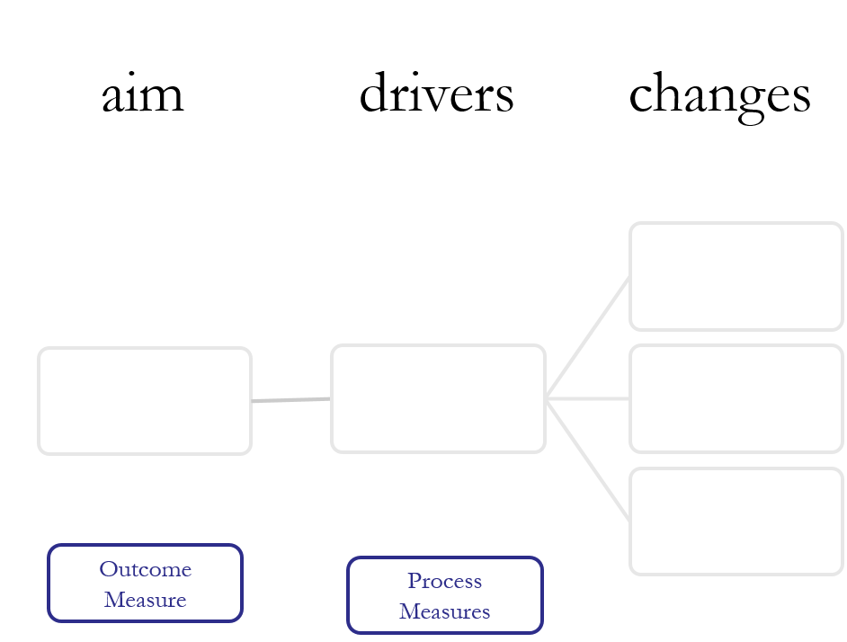
© Associates for Process Improvement
Drives
Effect
Cause

Slide 37
Improve – Implementation of Changes
PDSA
Write specific aim for the interventions
  For e.g., Each client with an identified behavior health need will receive 4 hours/month of behavioral health care.
  Change Measure:
  Numerator: number of patients who received 4 hours/month of behavioral health care
  Denominator: total number of patients (12) identified with behavioral health needs

Slide 38
The PDSA cycle for learning and improvement
Act
Plan
Objective
Questions and
predictions (why)
Plan to carry out the cycle
(who, what, where, when)
What changes
are to be made?
Next cycle?
Study
Do
Complete the
analysis of the data
  Compare data to
  predictions
    Summarize what
    was learned
Carry out the plan
Document problems
and unexpected
observations
Begin analysis of
the data

Slide 39
Repeated Use of Cycle
PDSA Measures
Changes That Result in Improvement
Learning from Data
A
P
S
D
D
S
Implementation of change
P
A
A
S
P
Wide-scale tests of change
D
A
P
Hunches Theories Ideas
S
D
Follow-up tests
Very small scale test
Notes:
Objective: Emphasize small tests of change that link and gradually get larger and larger
Explanation: After generating ideas, run Plan-Do-Study-Act (PDSA) cycles to test a change or group of changes on a small scale to see if they result in improvement. If they do, expand the tests and gradually incorporate larger and larger samples until you are confident that the changes should be adopted more widely A team learns from the test — What worked and what didn't work? What should be kept, changed, or abandoned? — and uses the new knowledge to plan the next test. The team continues linking tests in this way, refining the change until it is ready for broader implementation.
At times it seems a waste of time to test. However, even if you have a very high degree of belief in the success of the test, others might not. People are far more willing to test a change when they know that changes can and will be modified as needed. Linking small tests of change helps overcome an organization's natural resistance to change and ensure physician buy-in.
Bridge to next slide: There are several other reasons to test ….

Slide 40
Tips for PDSA Cycles
“What change could you test soon?”
Start Small
  “Rule of 1”:
    1 facility
    1 office
    1 provider
    1 patient
Notes:
We’ve learned:
Keep the first test small. Remember Dr. Smith and her 35-minute screening tool. Give yourself a chance to even to fail in this first test. Sometimes you learn the most from trying something that really doesn’t work. A common question to those starting their first PDSA cycle is: what change can you implement by next Tuesday? This question forces you to think small by reducing the sample size (‘just a few records’) and decreasing the implementation timetable (‘within a few days’) to a minimum.
One way to help you and your colleagues “keep it small” is to remember the Rule of 1. Design the first test for one facility, one office, one provider or one patient. See what happens, act on that knowledge, and then scale-up the test.

Slide 41
Change Plan
Plan for implementation (optional)
  List Key steps
  Time frame
  Who is responsible

Slide 42
Planning Tool
Gantt Chart is a program management tool. Tailor it to meet
your needs. Review QI Project Action Plan handout.

Slide 43
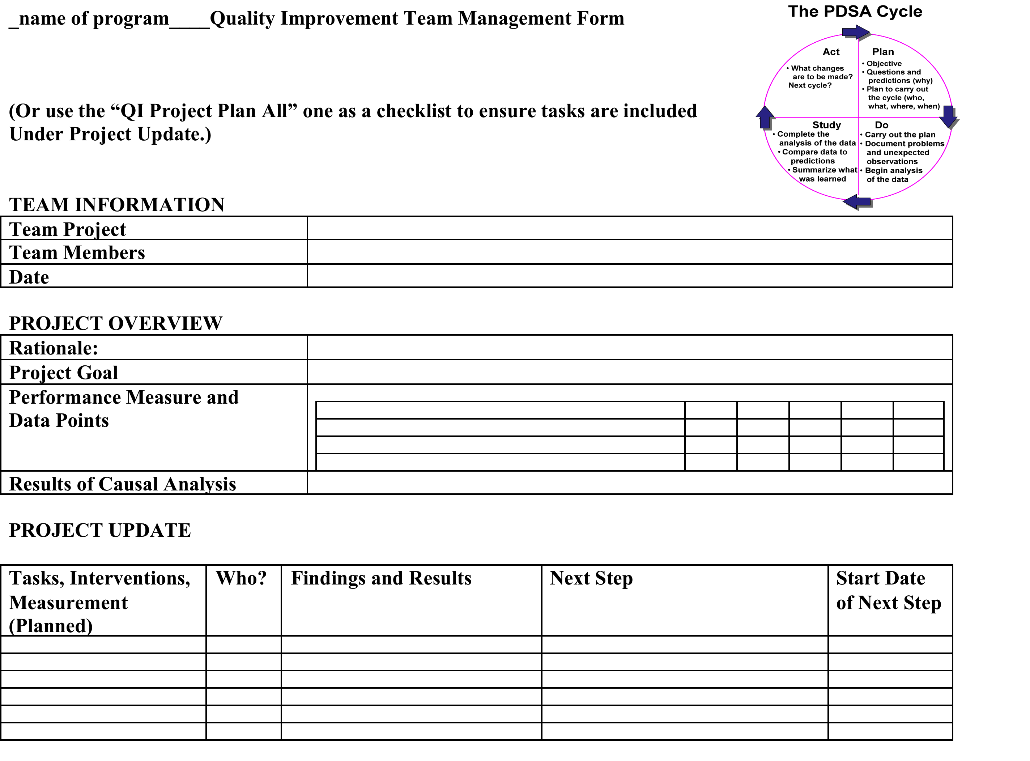

Slide 44
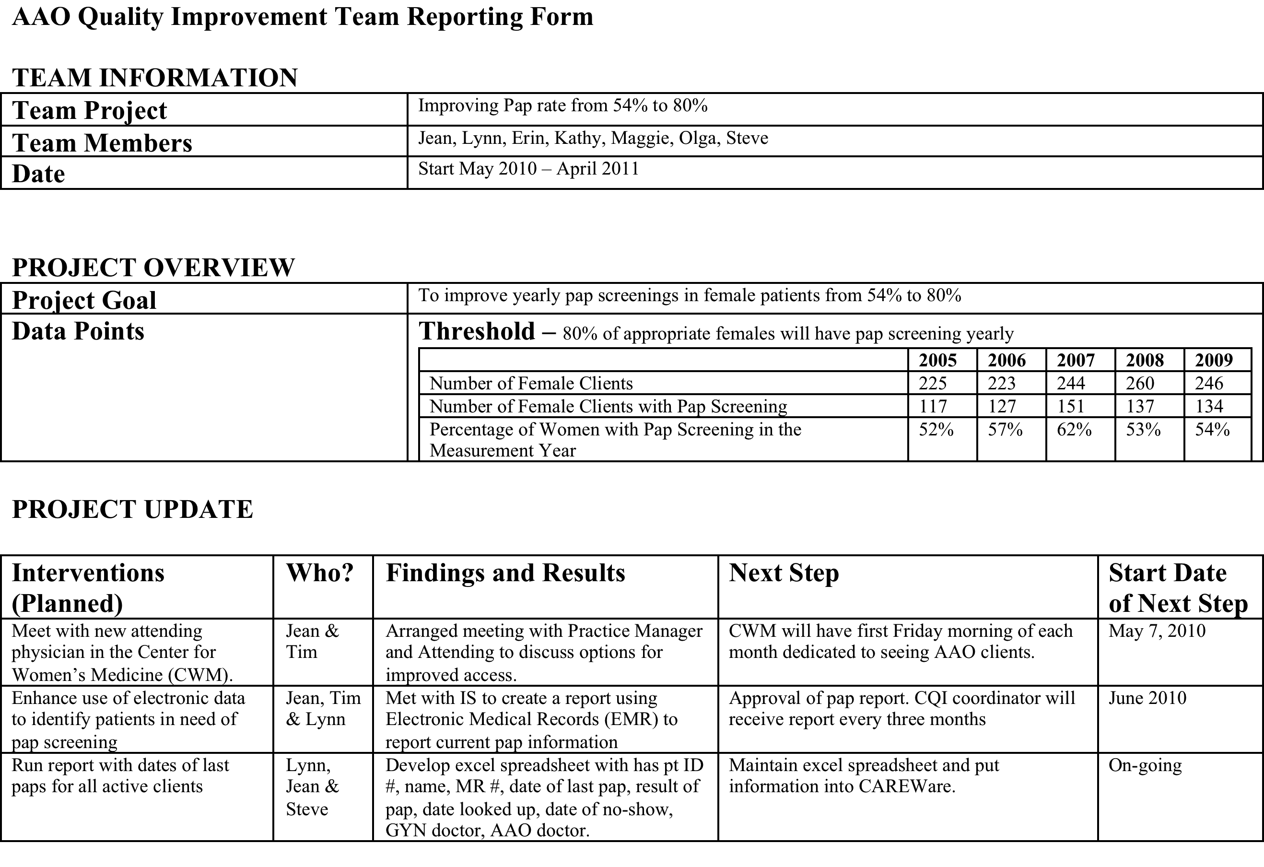

Slide 45
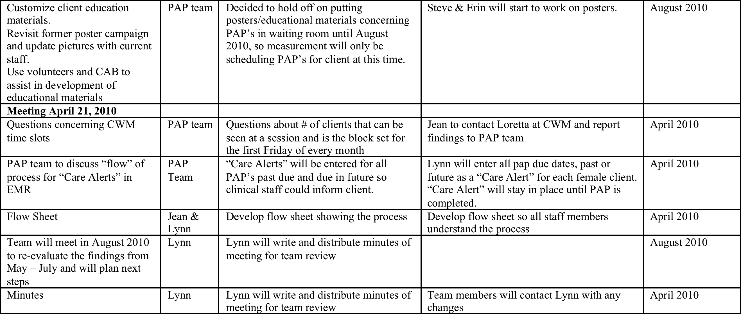
Team minutes contd

Slide 46
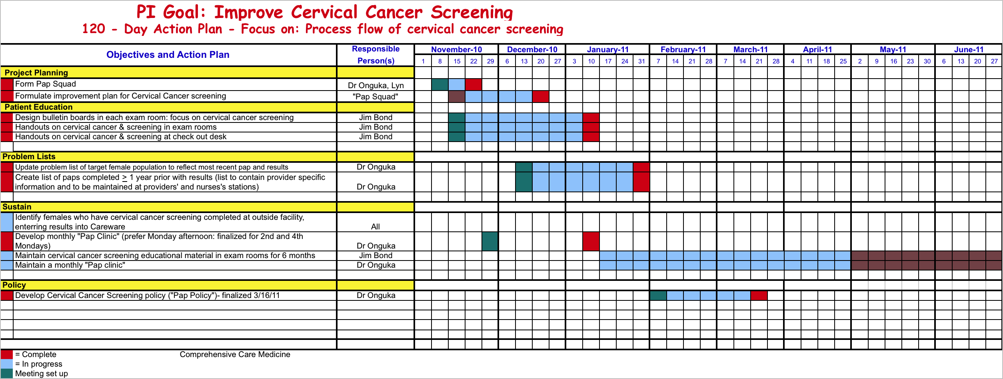
Lancaster General Hospital. Comprehensive Care Center. PA

Slide 47
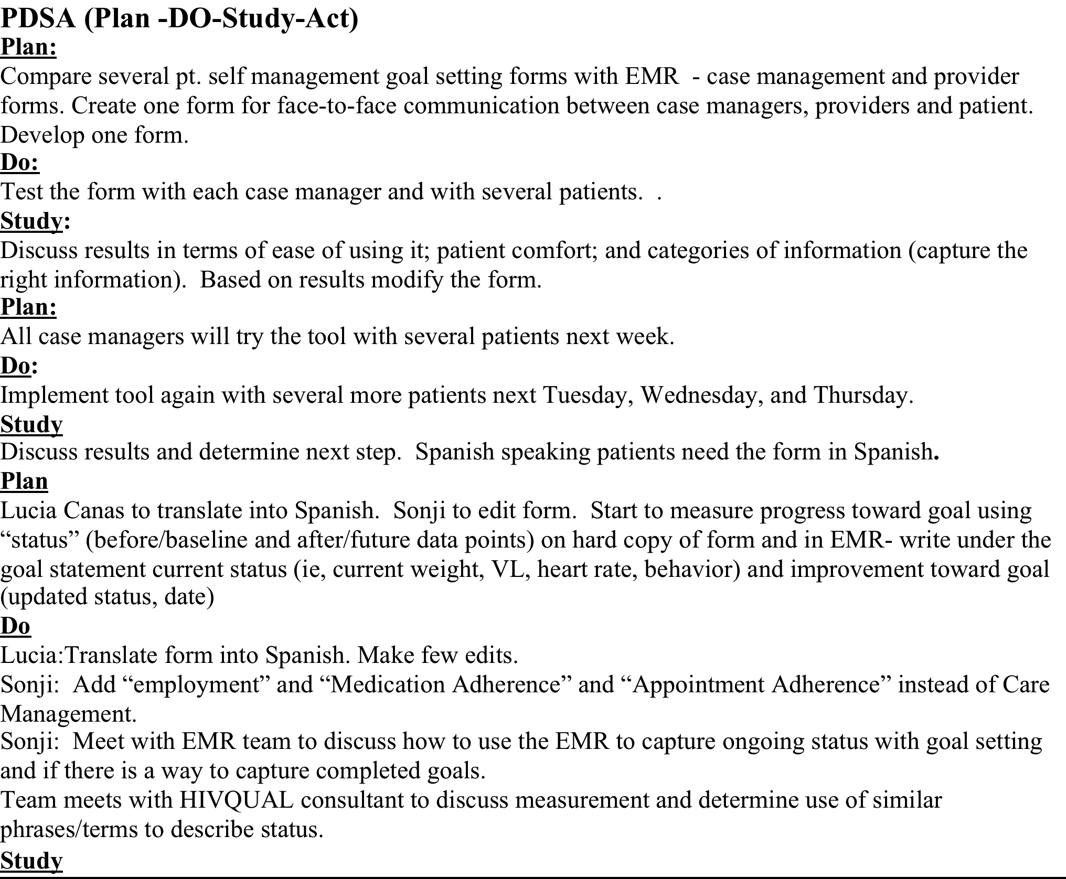
Patient Goal Setting – Lawndale CHC, Chicago
Flowcharts
Notes:
Let’s take a look at the steps to create a flowchart:
Agree at the beginning what the flowchart should accomplish and the level of detail you will need to accomplish that goal.
Then, identify the first and last step of the process. This sounds easier than it is. It can be hard to clarify exactly where the process begins and ends, but it is critical that you set these boundaries at the beginning.
Then begin filling in the steps, from first to last. If you come to a decision point, a diamond, choose the most-often occurring path and continue it all the way to the end; then go back and complete the second branch. You’ll get terribly confused if you don’t.
When you’re done, review the chart: read it out loud to the group for accuracy and make sure everyone understands it.
If you uncover parts of the process that aren’t clear, don’t guess. Assign someone on the team to find out “what really happens,” gather additional input and report back.

Slide 48
Do/Study
Concisely describe what happened during your tests of change
  Were you able to implement your plan? What changes did you need to make?
  What were your results?
    Quantitative – 12 of 112 not suppressed patients between 8/1/17 – 11/30/17 were identified has having mental health needs. All 12 of the patients were referred to the clinic’s behavioral health center; 6 of the patients kept their appointment. Of the 12, 3 were suppressed by 1/31/18.
    Qualitative data –When discussing the missed appointments with the behavioral health staff, they identified patients not keeping their first appointment and missed appointments. Behavioral health staff use an automated reminder system.

Slide 49
Study
Depending on the nature of your results:
Present data graphically (e.g. control chart, run chart, bar graph, line graph or other graphic representation). Add additional slides as needed.
Describe your observations and further modifications of your tests of change

Slide 50
Act
Based on your study or results, describe your follow up plans or what you will do for further investigation.
Example: Based on the number of missed appointments, the HIV case management staff including navigators will keep in contact with the patients and do follow up reminder calls, send text messages, target messages to remind patients to keep appointments.
Will you continue to test process changes using PDSA cycles?
  Example: Based on the results of HIV staff consistently contacting behavioral health patients, the HIV program will the degree of success of the approach. If successful, the approach will be standardized. If not, additional change ideas will be explored.

Slide 51
Act contd
Will you continue to test process changes using PDSA cycle?
The team will implement targeted interventions to individual patients and sub groups of patients.
The team will continuously report back results to the Multidisciplinary Team and make further changes as needed.

Slide 52
Control or Sustaining Gains
If your QI Project was successful, what are your next steps?
  How will you sustain gains?
  How will you integrate into delivery care system?
  How frequently will you monitor your results?
  To what extent did your focus on a sub group effect the overall suppression rate?

Slide 53
Control Steps
Review performance measurement data, i.e., trend charts (every two months, quarterly, twice/year)
Ensure tested solutions or interventions are sustained
Determine the need to test additional solutions to further increase results

Slide 54
Quick Check-in
Discussion
Comments
  What went well
  What could be improved

Slide 55

THANK YOU!

