Slide 1

Quality Management 101 Series
Module 1
Overview Quality Improvement
Nanette Brey Magnani, EdD, National QI Consultant
Diona Walker, MSPH, Services Quality Manager
Hosted by: Louisiana Department of Health HIV/STD Program sted by: Louisiana Department of Health-STD/HIV Program

Slide 2


Slide 3
Opening Remarks

Slide 4
Purpose
Expand QI culture in Louisiana by
building the capacity of leaders and staff to improve HIV+ and at risk patient care and
providing basic QI information in chunks that could then be used as part of staff orientation to QI at participants’ facilities.

Slide 5

QM 101 Series
Module 1: Overview - Quality Improvement
    April 11, 2018; 12:00 pm – 1:00 pm
Module 2: Quality Program Infrastructure
    May 9, 2018; 12:00 pm – 1:00 pm
Module 3: Performance Improvement
    June 6, 2018; 12:00 pm – 1:00 pm
Module 4: QI Project Steps and PDSA
    July 11, 2018; 12:00 pm – 1:00 pm

Slide 6
Coaching/Learning Approach
Experiential, hands-on, interactive
Series of modules via webinar
Applied work in between webinars
  Try out ideas
  Share experiences

Slide 7


First Things, First…
In the chat room, write:
Your Name
Your Role
What are your expectations for the series?

Slide 8
Session 1 Outcomes
Overview of Quality Improvement
  Understand HRSA/HAB grant requirements
  Develop a common knowledge and framework of QI Principles and QI terms
  Understand basic principles of Quality Improvement
  Become familiar with resources to support your QI staff/consumer orientation to QI

Slide 9
Basic Definition and Principles of
Quality Improvement

Slide 10

What is Quality Improvement?
Quality improvement
  is an organizational approach
  is a team-based, problem solving approach
  uses a specified set of principles and methodologies
  improves care
Notes:
keep

Slide 11

How the Institute of Medicine Defines Quality:
“Quality of care is the degree to which health services for individuals and populations increase the likelihood of desired health outcomes and are consistent with current professional knowledge. ”
Institute of Medicine. Medicare: A Strategy for Quality Assurance. Vol. 1. (1990)
Defining Quality
Notes:
Let’s begin with the experts.
The Institute of Medicine is part of the National Academy of Sciences, the most respected voice of the discipline of medicine in the United States. In 1990, the IOM produced a definition of quality of care that continues to be used throughout the health care system.
“Quality of care is the degree to which health services for individuals and populations increase the likelihood of desired health outcomes and are consistent with current professional knowledge.”
Let’s explore what this definition means for HIV care.

Slide 12







What Individuals and Populations Matter in HIV Care?
People with HIV and AIDS
Their partners, wives or husbands
Their children, families and friends
Their potential partners, or others whom they might infect
The people who provide health care and other supportive services to them
The communities in which they live and work
Defining Quality
Notes:
Who are the “individuals and populations” affected by HIV care?
People infected by HIV, of course, and the people who care about them.
Because HIV is an infectious disease, we are also concerned with reducing the rate of infection, so we also consider those who might become infected.
An illness as devastating as AIDS affects everyone in the community as well, as the community loses the potential resources provided by those who become ill.
Finally, the people who provide care and services also are part of the “populations who matter.” In the quality field we talk about both “external” and “internal” customers. “Internal customers” are those who provide products or services. “External customers” are those outside the organization: patients, clients, their loved ones, and the members of the community. Internal customers work in the organization. They all have things they need - information, equipment, supplies, time, updated knowledge - in order to provide care and services to the external customers.

Slide 13
Sub populations: Health Disparities
Youth (ages 13-24) are 5 times more likely to have HIV than people older than 25
African American women are 20 times more likely to have HIV than white women
Men who have sex with men are 46 times more likely to have HIV than other men
Transgender women are 50 times more likely to have HIV than other adults
http://www.unaids.org/sites/default/files/media_asset/08_Transgenderpeople.pdf
http://www.cdc.gov/hiv/pdf/statistics_hssr_vol_17_no_4.pdf
http://www.aidsmap.com/HIV-positive-youth-are-less-likely-than-adults-to-achieve-viral-suppression-on-antiretroviral-treatment/page/2994025/
http://www.cdc.gov/mmwr/preview/mmwrhtml/su6203a19.htm?s_cid=su6203a19_w
Notes:
Next, we’re going to dive into more detailed discussion about each of the 4 populations of focus.

Slide 14

Notes:
Why are we even talking about quality management & QI?
Ask the group to identify the reasons why we’re talking QM & QI

Slide 15
QUIZ
In 1601, James Lancaster successfully conducted an experiment to illustrate the effectiveness of lemon juice to prevent scurvy.
When did the British Navy adopt this treatment?
1602
1689
1757
1796

Slide 16
ANSWER
1602
1689
1757
1796
Notes:
- 1865 British Board of Trade adopted the policy for all ships in the merchant marine – 264 years later

Slide 17

Treatment of Scurvy
In 1601 lemon juice, as a protective against scurvy, is recorded by James Lancaster.
In 1612, Woodall recommended citrus fruit for protection against scurvy on sea voyages.
In 1753 James Lind published A Treatise on the Scurvy which portrays his experiment on-board the ship Salisbury in 1747.
From 1772 to 1775 sailors on historic voyages with Captain James Cook remained free from scurvy.
In 1796 lemon juice was officially introduced in the British Navy as a prophylactic against scurvy.
In 1865 British Board of Trade adopted the policy for the merchant marine.
Stephen J. Bown - Scurvy: How a Surgeon, a Mariner, and a Gentleman Solved the Greatest Medical Mystery of the Age of Sail; St. Martin's Press, 2004

Slide 18
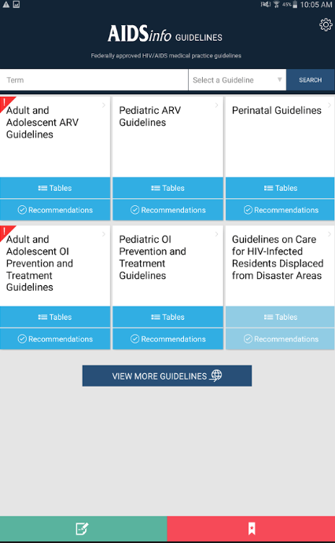

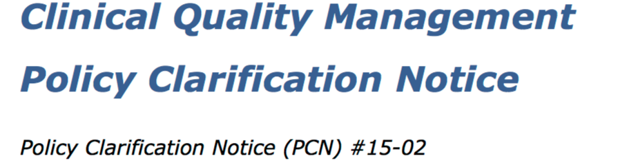
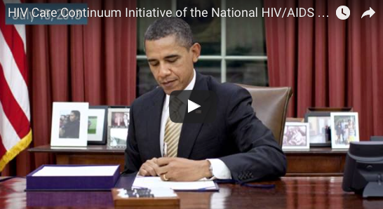


Notes:
All of these initiatives and materials guide the care and direction of the HIV programs. They set the bar, identify the key priorities and provide the framework in which we operate our HIV programs.
The CQM PCN specifically identifies the specific expectations of a quality program for Ryan White programs.

Slide 19
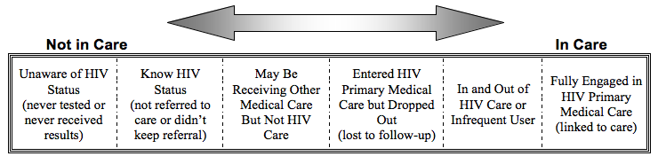
Engagement in Care Continuum
(HRSA)
Non-Engager
Sporadic User
Fully Engaged
[1] Health Resources and Services Administration, HAB. August 2006. Outreach: Engaging People in HIV Care Summary of a HRSA/HAB 2005 Consultation on Linking PLWH Into Care.
[2] Eldred L, Malitz F. Introduction [to the supplemental issue on the HRSA SPNS Outreach Initiative]. AIDS Patient Care STDS 2007; 21(Suppl 1):S1–S2.

Slide 20
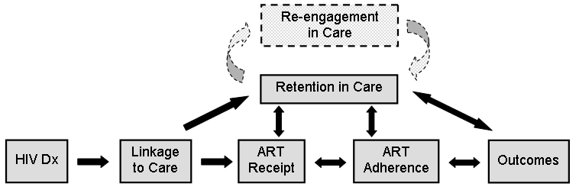
Blueprint for HIV Treatment Success
Ulett et al. AIDS Pt Care STDS 2009;23:41-49, Mugavero et al. Clin Infect Dis 2011;52(S2).

Slide 21
Quality Management Expectations for Ryan White Recipients (or Everything You Need to Know About PCN #15-02)

Slide 22
What’s a PCN Anyway?
Policy Clarification Notice
Reference documents:
  PCN #15-02 Clinical Quality Management Policy Clarification Notice
  FAQs: Clinical Quality Management Policy Clarification Notice (Released December 9, 2015)

Slide 23
RWHAP Expectation re Quality
RWHAP Parts A-D are required to establish a clinical quality management (CQM) program to ensure grant-funded services are consistent with the most recent HHS guidelines for the treatment of HIV & related OIs.
Guidelines for Part F are outlined in the individual FOA.
Implement strategies to improve the access to and quality of HIV services.
CQM is a major component that HRSA/HAB supports to optimize health outcomes & reduce HIV incidence.

Slide 24
RWHAP Expectation re Quality
It’s the responsibility of the Part A-D recipients to work with their subrecipients to implement, monitor & provide any needed data on the CQM program.
Include all services, including clinical & support services.
Coordination of CQM activities is encouraged across all RWHAP/other recipients & subrecipients within a service area with the aim of:
  Reducing the data burden,
  Alignment of performance measurement &
  Maximizing the impact of improved health outcomes.

Slide 25



Principles on the Quality Improvement Journey…
“Quality improvement is a journey of many small steps.”
Notes:
When talking about quality improvement, people often say ‘Quality is a journey of many small steps.’
Quality improvement is a huge undertaking that must both be broken down into manageable pieces and integrated into the daily functioning of your organization.
There are a few key principles that can help guide you in taking these steps.

Slide 26
PCN #15-02: Components of an Effective CQM Program
Infrastructure
Performance measurement &
Quality Improvement

Slide 27
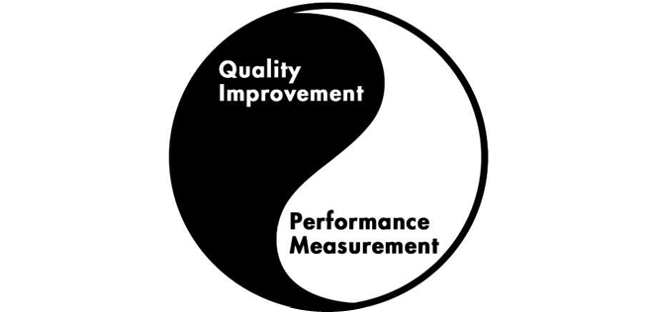


Slide 28
Infrastructure (Module 2)

Slide 29
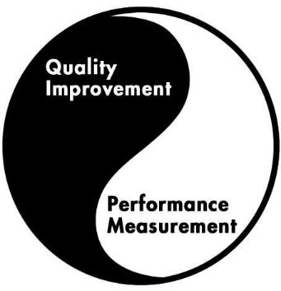
Principle: Infrastructure enhances systematic implementation of improvement activities.
Infrastructure

Slide 30
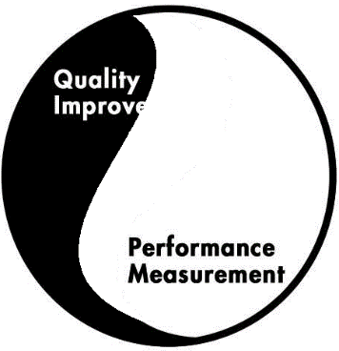
What We Want to Avoid……..
Quality
Management Program

Slide 31




PCN #15-02
Components of Quality Infrastructure
Leadership
Quality Committee
Quality Plan
Dedicated Staffing
(and delineated roles)

Slide 32



Components contd
Dedicated Resources
Consumer Involvement
Stakeholder Involvement
                Evaluation

Slide 33
Performance Measurement
(Module 3)

Slide 34
Principle: Every system is perfectly designed to achieve exactly the results it achieves.
Paul Batalden, MD, IHI Senior Fellow, The Dartmouth Institute
If this data could talk, what would it say?
Notes:
keep

Slide 35
Principles:
“Actions are Based Upon Accurate and Measured Data “
“You can’t improve what you can’t measure.”
What was the change?
How much of an effect did it have?
Quality Principles
Notes:
In order to efficiently improve processes, we must keep in mind another principle of quality improvement: in order to do quality improvement, we must collect data, otherwise we could not separate providers’ and consumers’ perceptions and anecdotes from what is really going on. Use “just enough” data in real time.
Although we are stressing data collection here, keep in mind quality improvement is not research.

Slide 36

PCN #15-02:
A sound portfolio reflects
  RWHAP funded services,
  local epidemiology &
  identified needs of PLWH.
Recipients are strongly
encouraged to include
  HAB and
  HHS measures that align with
NHAS.

Slide 37

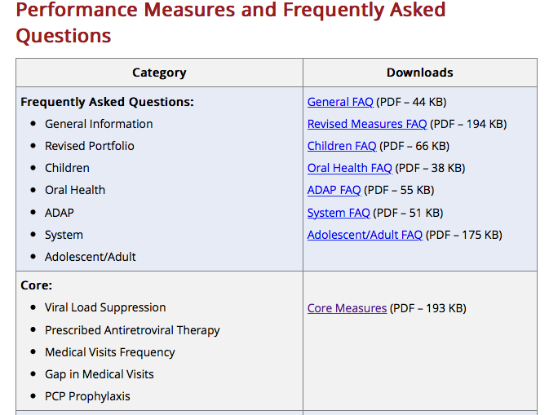
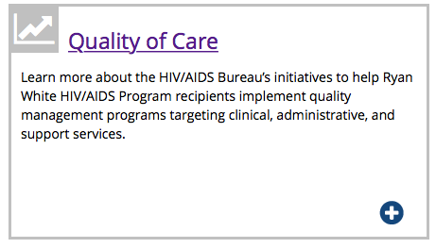
What do we measure?

Slide 38
Performance Measurement
Identified process to regularly collect & analyze performance measurement data (should occur at least quarterly per the PCN).
All RWHAP- funded service categories must have at least one performance measure; highly utilized & highly prioritized service categories should identify two performance measures.
If a recipient/subrecipient is doing well with various health outcomes, it is recommended that they stratify the PM data to see if there are potential disparities.

Slide 39
Quality Improvement
(Module 4)

Slide 40
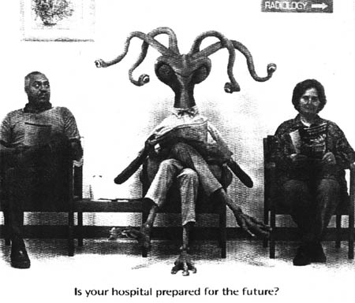
Principle : “Success is Achieved Through Meeting the Needs of Those We Serve”
Defining Quality
Notes:
First and foremost, success is achieved through meeting the needs of those we serve. Consumers are the ultimate recipients of care, and quality improvement activities need to address their needs. When developing indicators, realize that providers and consumers think about very different things: while providers would assess their quality of care more in terms of clinical indicators, consumers would assess the quality of care more on tangible perceptions of care such as waiting time and flow in the clinic.

Slide 41
Two Dimensions of Quality
Technical Quality
Provider Perception of Quality of HIV Care
Experience Quality
Consumer Perception of Quality of HIV Care
Leonard Berry, Texas A&M University, IHI conference 2001
Defining Quality
Notes:
Therefore, there are two dimensions of quality: provider perception of quality- clinical core elements - and consumer perception of quality. In order to improve care and services, we need to address both elements, the technical side and the experience side of quality.

Slide 42

Principle: Most problems are found in processes, not in people

Slide 43
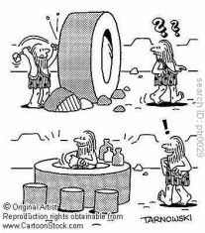
Principle: Do not reinvent the wheel – Learn from best practices.

Slide 44

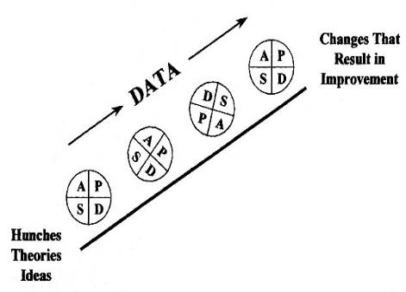

Principle: Achieve continual improvement through small, incremental changes

Slide 45
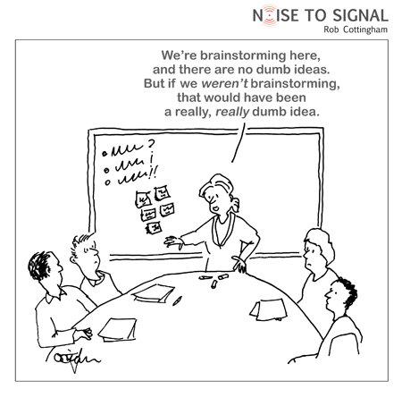

Principle: Develop solutions in teams. Group decisions are most likely to yield better results than a single person.
Examples
Care teams
Multidisciplinary teams

Slide 46
PCN #15-02 - QI
The goal is to:
  improve patient access,
  patient care,
  health outcomes &
  patient satisfaction
Should be implemented in an organized, systemic fashion

Slide 47
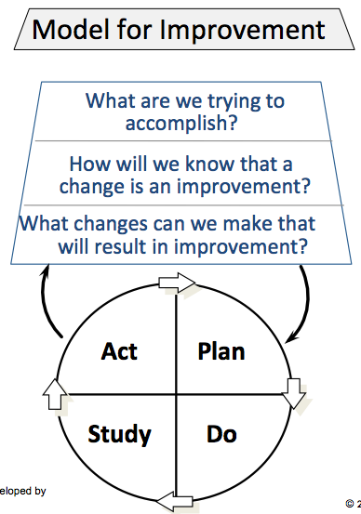
QI contd
Should use a defined methodology, e.g.,
IHI’s model for improvement, Lean, etc.
Must be documented – “If it wasn’t documented, …”
Per the FAQs, recipient should be conducting a QI project for at least one service category at any given time.

Slide 48
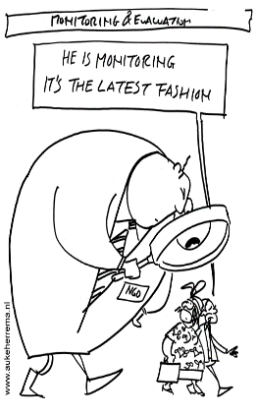
Quality Assurance
Please note: Quality assurance (QA) refers to a broad spectrum of activities (e.g., site visits & chart reviews) aimed at ensuring compliance with minimum quality standards. QA is part of the recipient’s administrative functions (& costs). They can inform the CQM program, but QA activities by themselves do not constitute a CQM program.
  Contracting, data collection & submission of reports, monitoring of subrecipients & compliance with audit requirements are administrative, not CQM activities.

Slide 49
Final Thoughts About Subrecipients
Part A & B recipients or Part C & D recipients with a network or subrecipient(s) are expected to implement a CQM program which includes their subrecipients as outlined in a written agreement. Recipients are expected to:
  Provide guidance on a performance measurement (PM) portfolio & the frequency of PM data collection;
  Identify improvement opportunities & monitor QI activities

Slide 50
In summary,
Principles guide your work.

Slide 51
Quick Check-in
Q & A
Comments
  What went well
  What could be improved

Slide 52
What supports measurement and improvement?
SAVE: May 9th; 12-1
Infrastructure

Slide 53
QI Training/Learning Resources
NQC Tutorials: www.nationalqualitycenter.org It will take you to careacttarget.org Center for Quality Improvement and Innovation, scroll down to Resources and click on Clinical Quality Management webpage
  Series of QI learning modules
  Beginner to advanced
  Ideas: Brown bag lunch learning group; pre-work. Other?
Interactive exercise: The HIV Care Satisfaction Continuum, pg 22. “Making Sure Your HIV Care is the Best It Can Be.”

Slide 54

Next Steps: Get Your Feet Wet
Review NQC tutorials before May webinar:
  Quality Academy
    Tutorial 2: What is Quality Improvement? How can key
    principles be applied in HIV care?
    Tutorial 5: Quality Management Plan
    Tutorial 6: Quality Management Infrastructure
  Quality Consumer Academy
    Quality Consumer Tutorial 4: Quality Improvement (not yet wait for Module 4)
Try an interactive exercise: The HIV Care Satisfaction Continuum, pg 22. “Making Sure Your HIV Care is the Best It Can Be.”
Start an orientation series with your staff and consumers.

Slide 55
THANK YOU!

