Slide 1
Louisiana
Ryan White
Part B & HOPWA
Case Management Guidance 2018

Slide 2
This Session
New Service Definitions and Standards
Changes to intake and reassessment procedures
Changes to care planning and case notes

Slide 3
Service Definitions and Standards
Notes:
These are very much living documents
I’m not expecting everything to be magically implemented overnight, this is a process

Slide 4
Service Definitions and Standards
Definitions
Standards
Based on HRSA’s Policy Clarification Notice from 2016 (PCN16-02)
Created specific parameters for the services provided through Ryan White
HOPWA services definitions from HUD
Universal Organization and Service Standards are set up by the State
Outline organizational requirements, and how the services should be delivered
All changes discussed today will become active in THIS contract period

Slide 5
Service Definitions
Services Funded Through Ryan White
Medical Case Management, including Treatment Adherence Services
Non-Medical Case Management Services
Mental Health Services
Oral Health Care
Child Care Services
Emergency Financial Assistance Services
Food Bank or Food Voucher Services
Health Education & Risk Reduction Services (HERR)
Housing Services
Medical Transportation
Psychosocial Support Services
Referral for Health Care and Support Services
Respite Care Services
Substance Use Outpatient Care
Other Professional Services
Outreach Services

Slide 6
Service Definitions
HOPWA Funded
Resource Identification (RI)
Short-Term Rent, Mortgage, and Utility Assistance (STRMU)
Tenant-Based Rental Assistance (TBRA)
Permanent Housing Placement (PHP)
Notes:
RI funded individuals will have a monthly report that must be submitted to SHP.

Slide 7
Changes to activities
Activities
Health Education and Risk Reduction can be used to support a benefits specialist position
Housing screening is mandatory for clients
Referrals should be entered in to CAREWare as services
Some activities are allowed past eligibility
We have raised the income cap from 300% FPL to 400% FPL to match the LAHAP requirements
Some services (mental health, and substance use) require a link to a primary care physician
SNAP Applications should be submitted annually if there is a change in income
Notes:
Referrals will have a $$ amount associated with them.
Housing screening is included in assessment and reassessment paperwork.
Referral to a primary care physician—which is required for mental health and substance use treatment can be billed as a regular referral.

Slide 8
Changes to Standards
Standards
Timelines are set out for case management activities
Recertification may occur at the end of the month of eligibility
Client’s may self attest of eligibility at their 6 month recertification in person or via phone or email
Assessments and acuity are required every 6 months
NMCM case load goals are 40 people per case manager & MCM 30 per case manager
Documentation of services shall occur within two business days of delivery
All documentation of services must be completed by the person providing the service
All case managers are required to have 20 hours of continuing education per year including 1 hour of education centering on LAHAP
Notes:
Initial assessment should be conducted within 5 working days of intake.
If the Intake completion is delayed because of missing documents, during the 30 day calendar period, someone must notify the client at least 3 times about what documents are missing.
Care Plan based on client’s goals, including a housing plan, is created within the first 30 calendar days of services.
Mailings of any type are not billable activities under Non-Medical Case Management.

Slide 9
Non Medical Case Management

Slide 10
Intake and assessment
Intake and annual assessment
6 month reassessment and eligibility
Contact and demographic information
Assessment
Screening tools
Care plan
Confidentiality statement
Release of information
Single provider statement*
Truncated reassessment
Screening tools
Updated care plan
Self attestation of eligibility
Notes:
Initial assessment is about 10 pages, not including the screenings.
The re-assessment is about 6 pages, not including screenings.
Screening tools are part of the assessment now, and will generate a consistent way to track a client’s depression/anxiety/trauma/substance use. In the future we may ask for the individual assessment numbers to be input into CAREWare, but for right now we are just using the overall acuity score.
There is a sample confidentiality statement on the LAHealthHub website. You are welcome to use it or another one that has been developed internally by your agency.
If an individual is not in your service area and wants to receive services at your location have them sign the single provider statement.

Slide 11
Screenings
Screenings in Assessment
Administering the Screenings
PHQ-9 for Depression
GAD-7 for Anxiety
PC-PTSD for Trauma*
CAGE for Alcohol Use
DAST-10 for Drug Use
Give to client to read, or ask and have the CM fill out
Include scores on assessment paperwork
Use to inform acuity score
Notes:
Take out your document titled “Screenings and scoring”
PTSD scale is optional

Slide 12
Acuity Scale
About the Scale
Data Entry Requirements
Numbered between 1 and 104
Weighted categories for Housing, Mental Health, and Substance Use
The number will be entered into CAREWare at initial assessments, annual assessments, and 6 month reassessments
Notes:
Use your best assessment to decide on the number that you will give for your client in a given area.

Slide 13
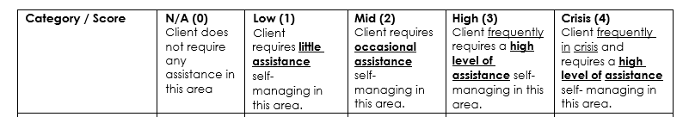
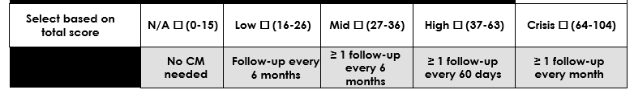
Notes:
We’ve added a NA column (thanks to Donna for pointing this out) that allows for someone to score lower than a 16 on the scale. Logically there are some areas where N/A may be common—legal, perinatal for men, evacuation and crisis for those not in flood/tornado prone areas, dental with no issues etc, transportation for people who have a working car
Home visits are required annually for clients with an acuity score above 37

Slide 14
Encounter Topics
Intake
6 Month Reassessment
Inclusive of eligibility determination. May be done by a case manager and billed under the Non-Medical Case Management service, or may be done by a benefits specialist and billed under Health Education. This is the only time that proof of HIV status is required.
Inclusive of eligibility recertification. SHP required reassessment paperwork, acuity scale and care plan. Self-attestation may be used at this reassessment if no changes have occurred to client’s income, residency or insurance status.
Follow-Up
Initial Assessment
Client contact not for assessment or eligibility reasons. This encounter should address the goals set forth in the care plan, and any emerging needs that the client may have.
SHP required assessment paperwork, acuity scale and care plan. This encounter topic should be used for the first assessment only.
Notes:
All of these can be face to face or non face to face. VERY rarely should Intake, or initial assessment be non face to face.
6 month reassessments may be conducted over the phone for individuals with an acuity scale under 37.

Slide 15
Encounter Topics
Annual Reassessment
Housing
Completed yearly, inclusive of eligibility recertification. SHP required reassessment paperwork, acuity scale and care plan. Additionally, this topic should be used if a client falls out of care, and returns at a later date.
Assistance with locating housing, applying for housing, or other housing related activities.
Insurance
Assistance with LAHAP, HIP, Health Insurance Marketplace/ACA, Medicaid or Medicare.
Home Visit
Case Conferencing
Only required for clients with an acuity score above 37. May be conducted for clients with an acuity score below 37 as needed.
Formal case conference to discuss updates and next steps for clients. This encounter topic may only be used by Case Management Supervisors.

Slide 16
Encounter Topics
Case Closure
Transportation Coordination
Closure of a case, or transfer to another agency. Reasons for case closure include:
  Client has achieved goals in care plan and is moved into self-management
  Client is no longer eligible for Ryan White Part B services or has moved to another service area
  Client has requested for services to be closed
  Client has acted in a way that puts provider personnel in danger
  Client cannot be contacted after repeated attempts over a 12-month period including the 6-month reassessment requirement
  Client dies
Assisting a client with transportation needs to medical or social service appointments.
Other
Other topics not represented previously.
Notes:
Reason for closure should be in the case notes.
Video Conferencing for individuals coming out of incarceration should be tracked under the existing video conferencing services.

Slide 17
Outreach & Referral Activities
Outreach
Referral
Billed in 15 minute increments.
Intended for individuals who have missed their 6 month reassessment.
Should be conducted between the 6 month missed reassessment, and the one year mark.
The case should be closed one year after their last assessment if no contact is made.
Requires a case note.
Billed as a single unit per referral.
Referral and direction of clients to medical, psychosocial and educational resources as deemed necessary.
Referrals may only be billed as a service if they are to outside agencies.
Must be referenced in case notes.
Notes:
Outreach
Outreach Services include the provision of reengagement of people who know their status into health services.
Referral
Referral and direction of clients to medical, psychosocial and educational resources as deemed necessary.
NOT for internal referrals.
Must be entered in as a service with notes.
Megan will be going over the specifics of entering referral services next week.

Slide 18
Who can bill for this?
Social Work Units
Other Staff Units
This unit may be billed by anyone with a social work (RSW, CSW/LMSW, LCSW) counseling (PLPC, LPC, PLMFT, LMFT), or addiction counseling (RAC, CAC or LAC) license.
This unit may be billed by any individual without a mental health licensure. Staff must meet minimum education requirements set forth in the Ryan White Part B and HOPWA Universal Organization and Service Standards.

Slide 19
Self Attestation
 | Initial Visit and Yearly Recertification | 6 Month Recertification
HIV Status | LAHAP Proof of Positivity Form, Letter from MD, Medical Records, CERV from New Orleans EMA *Documentation is not required after intake | No documentation necessary
Income | Pay Stubs, Disability Determination Letter, W2, benefit award letter, Certification of No Income/Cash Only Income, CERV from New Orleans EMA | Self-attestation of no change, Self-attestation of change with documentation, full documentation
Residency | Louisiana Driver’s License, Louisiana ID, utility bill, voter registration, Social Security Statement, CERV from New Orleans EMA | Self-attestation of no change, Self-attestation of change with documentation, full documentation
Insurance Status | Medicaid card, Medicaid denial letter, private insurance card, private insurance termination notice, Medicare card, LAHAP application or approval, CERV from New Orleans EMA | Self-attestation of no change, Self-attestation of change with documentation, full documentation
Can be in person, by phone or by email depending on acuity.
Should be used at the 6 month recertification.
Clients with an acuity score between 0 and 36 may complete their reassessment via phone. Individuals over 37 should have a face to face reassessment.
Use the Part B Self Attestation Form

Slide 20
Reassessment at 6 months
Notes:
Clients with an acuity score between 0 and 36 may complete their reassessment via phone. 37-104 should be done in person (in the office, or at a home visit).

Slide 21
Changes to Care Planning and Case Notes

Slide 22
Documentation Standards
Case notes are required for every service delivered
SOAP
DAP
Subjective—Subjective or summary statement by the client.
Objective—Data or information that matches the subjective statement.
Assessment—Assessment of the situation, or issue, based on the subjective and objective statements.
Plan—Plan for next steps.
Describe—Subjective and objective statements that demonstrate the basic content of the interaction.
Assess—Assessment of the situation, or issue, based on the subjective and objective statements.
Plan— Plan for next steps. Should reflect the goals in the care plan.
Notes:
CAREWare has both of these templates available for your use starting now.
Additional guidance is available in the document that I handed out.
Notes must be entered by the person who completed the service, within two business days of the service, and reflect the correct date

Slide 23
Care Plans
First Care Plan
Care Plan Updates
Must be created within 30 days of initial assessment
Should be based on outcomes of the assessment
Should be collaborative with the client
Should have goals in a SMART format
Can be the same or new goals
Must be updated every 6 months (even if they update is to continue with the same goals)

Slide 24
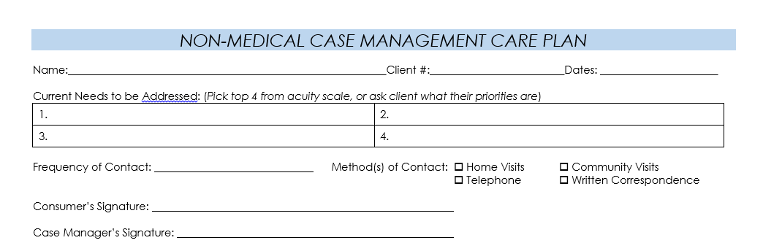

Slide 25
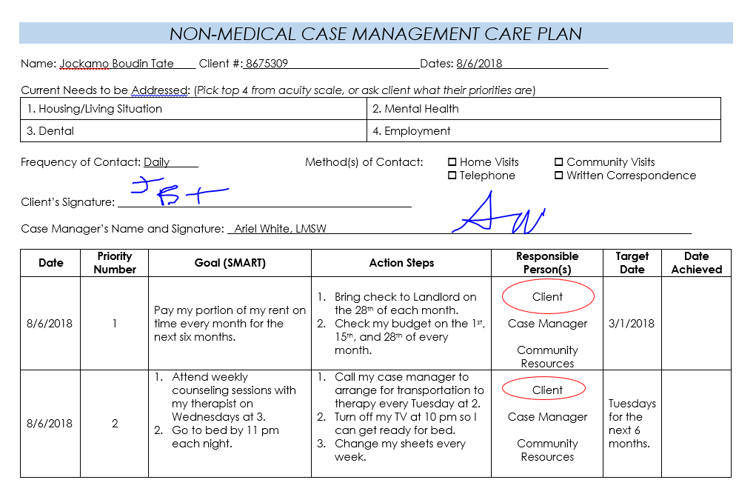

Slide 26
Additional Documents
To be used based on the client
Part B Certification of No Income/Cash Only Income
Employer Income Verification
Single Provider Statement
Activity logs for Child Care and Respite Care
Food Bank Allowed Product List 2018
Sample Consent to Text Message

Slide 27
Additional Services

Slide 28
Additional Services
Psychosocial Support Groups
Mental Health Services
Oral Health Services
Substance Use Outpatient Services
Food Vouchers
Emergency Financial Assistance
Housing Services

Slide 29
Additional Services
Mental Health Services
Psychosocial Support Groups
Mental health notes may be kept separately from case management notes. In house practitioners should have notes available to Monitor upon request.
Providers do not have to be mental health professionals.
Attendance must be kept for all group sessions.
A group note should be present in the file of every attendee. These may be the same note for all participants.
Oral Health Services
Referrals should be made to practitioners that have experience with working with people living with HIV.
A treatment plan should be retained by the agency and should be available to Monitor upon request.
Notes:
Mental health--If the agency is using an outside contractor, notes do not have to be available.

Slide 30
Additional Services
Food Vouchers
Substance Use Outpatient Services
Providers must be licensed mental health professional in the state of Louisiana.
Must have treatment plan within the first 30 days.
Service providers must link clients seeking substance use services to a primary care provider within the first 14 days of care. Housing Services
Must screen clients for other food programs.
Must be able to ensure that vouchers are not used on ineligible items.
Individual vouchers should not exceed $ 25 in amount. There is no cap on the amount of vouchers given to an individual.
Housing Services
Emergency Financial Assistance
Assistance includes negotiating housing payments, as well as providing financial assistance to maintain or obtain housing, which supports the client’s ability to gain or maintain access to medical care.
If housing services include other service categories (e.g. meals, case management, etc.) these services should also be reported in the appropriate service categories.
Requests should be completed within 2 business days.
One payment in each sub-category of this definition may be made on behalf of self-declared people living with HIV.
Notes:
Emergency Financial Assistance
Payments may be made on behalf of eligible clients who are unable to access assistance from other resources or other Ryan White categories; while awaiting intake to medical care or confirmation of HIV status; while awaiting intake or results from applications to Medicaid or other social services; or who have a case manager documented emergency not covered by another service category.
Can be used for utilities, housing, transportation and medications
Food Bank Guidance is available on the website. This should be needs based.

Slide 31
How do I ________________?
Check Louisianahealthhub.org/support-services
Ask your Case Management Supervisor
Call Ariel
Notes:
Peer networks will be established in the next year.

Slide 32
Changes to HOPWA

Slide 33
All Programs
Resource ID, TBRA, STRMU, PHP
Violence Against Women Act (VAWA) changes require organizations to have an Emergency Transfer form, plan, lease addendum and Notice of Occupancy Rights
Anyone doing a home inspection/visit should be trained on the Lead Base Paint training available through the HUD Exchange
Housing Quality Standards should be completed at the beginning of the subsidy
STRMU can be used for late fees if they pose a risk of eviction
Notes:
HOPWA is silent about undocumented individuals.
Part B service area will be getting some more money in the next contracting period. It will allow for additional people to be served. The idea at SHP is to move additional individuals on to the TBRA program.

Slide 34
New HOPWA documents will be made available this quarter.
Notes:
I am in the process of going through TA with our TA providers. We will have additional trainings, and new documents for all aspects of the TBRA program this year. Keep an eye out for the new documents and training announcements.

Slide 35
Resource Identification
Provider shall ensure that activities conducted utilizing resource identification funds will complement activities conducted under the other HOPWA programs including TBRA, STRMU and PHP.
Provider(s) must demonstrate the capacity to expand housing resources in their service area (for all eligible clients living with HIV, not just clients of the service provider).
Providers must develop and maintain a housing resource directory for the benefit of clients, staff, and collaborative agencies.
Staff funded through Resource Identification will be required to submit monthly documentation on their activities.

Slide 36
STRMU
Providers must work with clients to develop a care plan that addresses the clients’ housing needs, and that demonstrates a plan for the procurement of long-term housing.
Client eligibility is to be re-certified, at a minimum, on the anniversary of the client’s 52 week eligibility period. The minimum time frame for determining client income shall be no more than the previous twelve months, but no less than the previous three months.
Organizations must have in place a policy describing how they intend to calculate the weeks of service within the 52 week eligibility period. Guidance from HUD on how to calculate weeks of service can be found at LAHealthHub.com/Services.
Copies of client’s bill, and proof of payment must be submitted with invoice to SHP.
Notes:
Can’t be used for first month’s rent, or deposits, moving assistance, household supplies, automobile expenses, telephone bills

Slide 37
TBRA
Providers must work with clients to develop a care plan that addresses the clients’ housing needs, and that demonstrates a plan for the procurement of long-term housing.
After 24 months, and additional assessment must occur, along with a continuation request
Documentation of Rent Payment Calculations must be kept on file.
TBRA funded units must be assessed for their eligibility including:
  Rent Reasonableness
  Fair Market Rent
  Lead Based Paint
  Habitability Standards
  Proof of Ownership
  Proof of smoke detector
Copies of client’s lease must be submitted with the first invoice to SHP.

Slide 38
PHP
Units paid for through PHP should meet the basic Habitability Standards outlined at 24 CFR 574.310 (b) (2)
Security deposits are program funds that must be returned to the program when the assisted tenant leaves the unit. A good faith effort must be made to recover program funds upon the departure of the beneficiary from the unit. These efforts should be documented in a case note.
HUD requires that organizations track and report costs separately as HOPWA housing subsidy assistance expenses.
Copies of client’s bill or lease, and proof of payment must be submitted with invoice to SHP.
Notes:
PHP cannot be used for payment of first month’s rent in conjunction with any other form of housing assistance and/or subsidized housing that already provides a payment for first
month’s rent, nor can PHP be used to pay the tenant’s portion of first month rent.
The total amount can not exceed the value of two months rent.

Slide 39
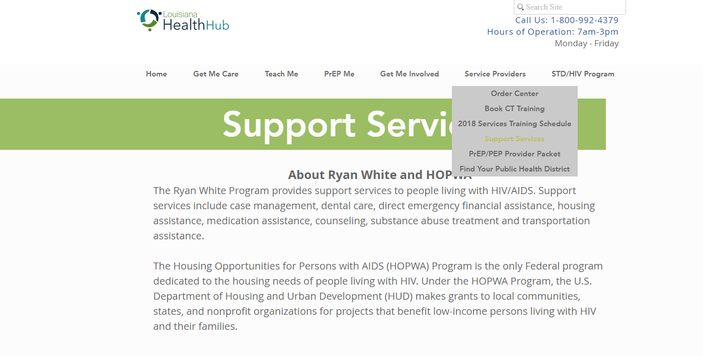

Slide 40
Contact info:
Ariel White
Ariel.White@La.gov
504-568-5448

