Slide 1
Louisiana
Ryan White
Part B & HOPWA
Invoicing, Monitoring and Reporting

Slide 2
Invoicing
Notes:
Changes to invoicing will be put in place with new contracts.

Slide 3
Invoice Submission Policy & Procedure
Late submission of invoices beginning 10 business days after the stated due date will incur a $50 per working day per invoice fee. Late fees may be waived by the SHP office on a case by case basis. If there are any delays in the process of submitting the invoice email Ariel.White@La.gov
Generate CAREWare Financial Report
Complete HOPWA Payment Breakdown
Gather supporting documentation for submission
Complete invoice
Place invoice, CAREWare Financial Report, HOPWA Payment Breakdown, and supporting documentation in Invoice folder via Citrix.
Email Capucinca.Harris-Roberts@la.gov to inform that invoice is submitted.
Notes:
On the 25th of the month late feels will begin on incur.

Slide 4
Invoice Correction and Data Check Policy & Procedure
Complete Data Check Corrections from SHP within 10 business days of receipt.
Email Ariel.White@La.gov and Rebekah.Puebla@La.gov to notify of Data Check Corrections completion.
If invoice corrections are needed, respond to SHP communication within 5 business days.
  Amounts under $200 may be removed or added to the following month’s invoice.
Resubmit invoice or approve next month amount change via email if needed.
Notes:
If more than 2 months in a row have errors that require change on a subsequent month you will be required to resubmit the invoice entirely.

Slide 5
Required Documentation
HOPWA
  CAREWare generated financial report
  HOPWA Payment Breakdown
  Supporting documentation for payments made under a given program
    STRMU, PHP and first TBRA payment
      Bill or invoice to be paid
      Proof of payment
RWHAP
  CAREWare generated financial report
  Supporting documentation for direct payments made under a given program
    For EFA, RWHAP Housing, also include
      Bill or invoice to be paid
      Proof of payment
Notes:
For Child Care and Respite Care the logs should also be submitted as the service is delivered. TBRA lease is only required upon the first payment, or on lease renewal.

Slide 6
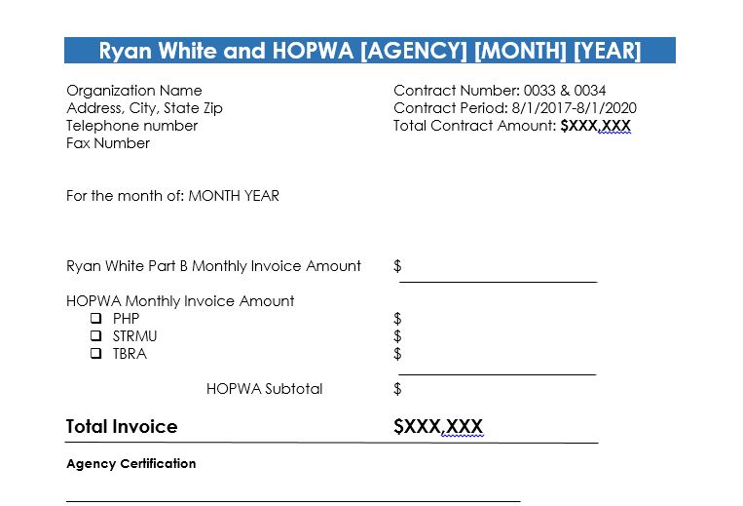
Required invoice template

Slide 7
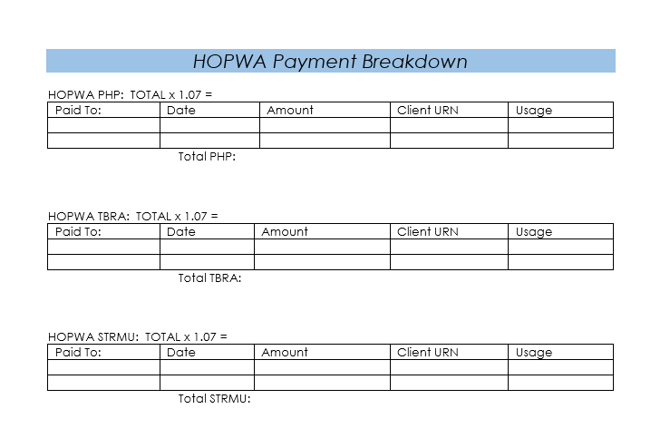
Required HOPWA break down

Slide 8
Monitoring

Slide 9
Monitoring
Monthly
  Data checks sent from SHP
Quarterly
  10 files will be randomly pulled by SHP staff and sent to the Case Management Supervisor. These 10 are expected to be monitored for eligibility completion.
  Results will be submitted in the quarterly director’s report.
Notes:
We are monitoring on the Universal Organization and Service Standards that are inclusive of the HRSA monitoring standards.
Annual monitoring visits will be made. We will be doing a formal site visit—which means we will be monitoring on not only the organizational standards, but also on all of the standards associated with the funding categories that you have been awarded in the 2018 contracts.

Slide 10
Organizational Monitoring Standard
6 | Standard | Measure
6.1 | Program Compliance
6.1.A | Agency shall monitor for programmatic compliance on a periodic basis. | Provider has documentation of self-monitoring for programmatic compliance.

Slide 11
Monthly Monitoring from SHP
Data check and completion
Monitor checks all totals on invoice against CAREWare data.
Monitor pulls 10-12 service entries at random to audit.
  Substantially higher units per service will also be monitored.

Slide 12
Reporting

Slide 13
Required Reports
SHP Reports
Federal Reports
Quarterly Director’s Reports
  Due by the last Friday of every quarter
Monthly Resource Identification Reports
  Due by the last Friday of every month
CAPER
RSR

Slide 14
New CAREWare Reports
(Agency) Active Clients w/No CM Service in 6+ MThs
  Clients w/no CM Service (Part B) in Over 6 months
(Agency) Active Client List
  Active client list with address and phone # all CM
(Agency) Active Clients with Pending Referrals
  Active clients with referrals in pending status
(Agency) Date of Last CM Service
  Date of last CM service within selected span for active clients
(Agency) Eligibility Expired- All CM
  Active clients with an eligibility date older than 6 months- includes all case mangers
(Agency) Eligibility Expired- (CM Name)
  Active clients with an eligibility date older than 6 months- Includes only the listed case manager’s clients
(Agency) Eligibility Expiring in 1 Month- All CM
  Active clients with an eligibility expiring next month- includes all case mangers
(Agency) Eligibility Expiring in 1 Month- (CM Name)
  Active clients with an eligibility expiring next month- Includes only the listed case manager’s clients
(Agency) Eligibility Status
  All Part B eligibility entries within the selected span for active clients
(Agency) FPL Expiring in 1 Month All CM
  Active clients with FPL expiring next month- includes all case mangers
(Agency) FPL Expired- All CM
  Active clients with a FPL date older than 6 months- includes all case mangers

Slide 15
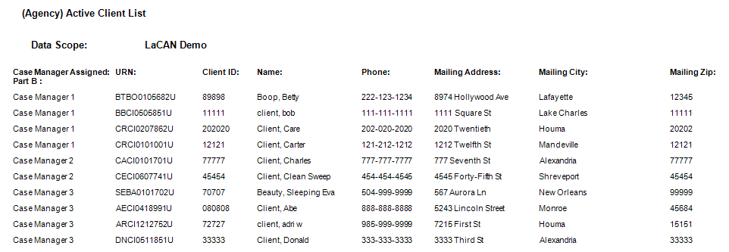
(Agency) Client List

Slide 16
(Agency) Active Clients w/No CM Service in 6+ MThs
  Description
    Clients w/no CM Service (Part B) in Over 6 months
  Fields in Report:
    Case Manager Assigned: Part B
    URN
    Client ID
    Name
    Date of Last Case Management Service

Slide 17
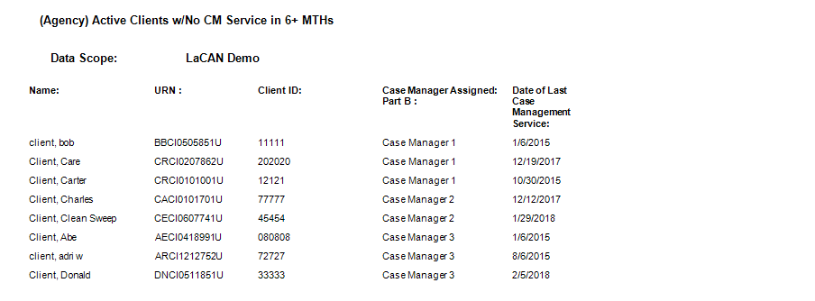
(Agency) Active Clients w/No CM Service in 6+ MThs

Slide 18
(Agency) Active Clients with Pending Referrals
  Description
    Clients w/no CM Service (Part B) in Over 6 months
  Fields in Report:
    URN
    Client ID
    Name
    Referred To
    Referred For
    Referred for if Other
    Appointment date if Applicable
    Final Referral Outcome
    Staff or Provider Name

Slide 19
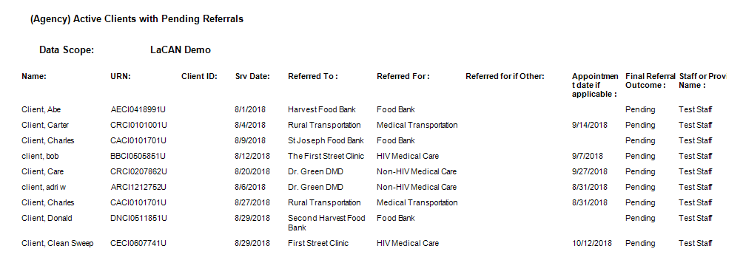
(Agency) Active Clients with Pending Referrals

Slide 20
(Agency) Date of Last CM Service
  Description
    Date of last CM service within selected span for active clients
  Fields in Report:
    Case Manager Assigned: Part B
    URN
    Client ID
    Name
    Date of Las Case Management Service
    Service name

Slide 21
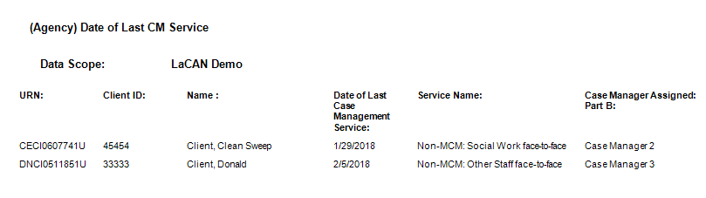
(Agency) Date of Last CM Service

Slide 22
(Agency) Eligibility Expired- All CM
  Description
    Active clients with an eligibility date older than 6 months- includes all case mangers
  Fields in Report:
    Case Manager Assigned: Part B
    URN
    Client ID
    Name
    Last Eligibility Date
    # of Months Since Last Eligibility Date

Slide 23
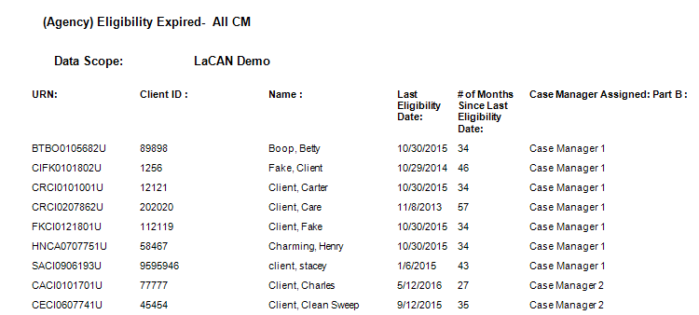
(Agency) Eligibility Expired- All CM

Slide 24
(Agency) Eligibility Expired- (CM Name)
  Description
    Active clients with an eligibility date older than 6 months- Includes only the listed case manager’s clients
  Fields in Report:
    Case Manager Assigned: Part B
    URN
    Client ID
    Name
    Phone
    Last Eligibility Date
    # of Months Since Last Eligibility Date

Slide 25
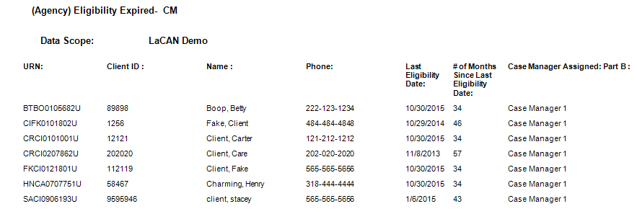
(Agency) Eligibility Expired- (CM Name)

Slide 26
(Agency) Eligibility Expiring in 1 Month- All CM
  Description
    Active clients with an eligibility expiring next month- includes all case mangers
  Fields in Report:
    Case Manager Assigned: Part B
    URN
    Client ID
    Name
    Last Eligibility Date
    # of Months Since Last Eligibility Date

Slide 27
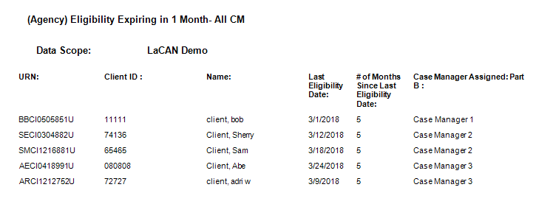
(Agency) Eligibility Expiring in 1 Month- All CM

Slide 28
(Agency) Eligibility Expiring in 1 Month- (CM Name)
  Description
    Active clients with an eligibility expiring next month- Includes only the listed case manager’s clients
  Fields in Report
    Case Manager Assigned Part B
    URN
    Client ID
    Name
    Phone
    Last Eligibility Date
    # of Months Since Last Eligibility Date

Slide 29
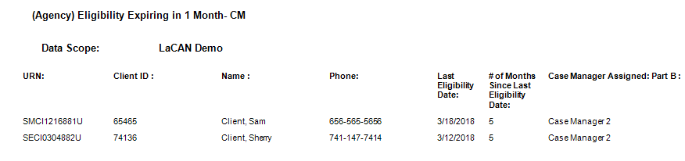
(Agency) Eligibility Expiring in 1 Month- (CM Name)

Slide 30
(Agency) Eligibility Status
  Description
    All Part B eligibility entries within the selected span for active clients
  Fields in Report
    Case Manager Assigned: Part B
    URN
    Client ID
    Name
    Eligibility Date
    Eligibility Funding Source
    Eligibility Status

Slide 31
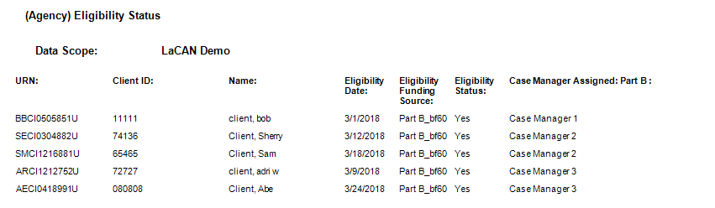
(Agency) Eligibility Status

Slide 32
(Agency) FPL Expiring in 1 Month All CM
  Description
    Active clients with FPL expiring next month- includes all case mangers
  Fields in Report
    Case Manager Assigned: Part B
    URN
    Client ID
    Name
    Date of Last Poverty Level in Span
    # of Months Since Last FPL Date

Slide 33
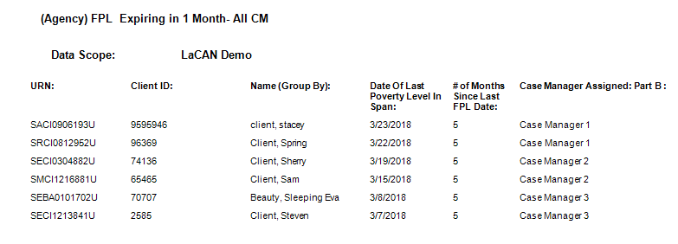
(Agency) FPL Expiring in 1 Month All CM

Slide 34
(Agency) FPL Expired- All CM
  Description
    Active clients with a FPL date older than 6 months- includes all case mangers
  Fields in Report
    Case Manager Assigned: Part B
    URN
    Client ID
    Name
    Date of Last Poverty Level in Span
    # of Months Since Last FPL Date

Slide 35
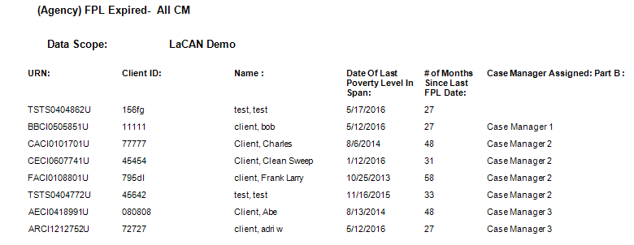
(Agency) FPL Expired- All CM

Slide 36
Contact Info:
Rebekah Puebla
Phone (504)568-8367
Rebekah.Puebla@LA.gov

Slide 37
Questions?

