Slide 1
Louisiana Ryan White Part B & HOPWA Data Management Update 2018

Slide 2
This Session
CAREWare data entry timeline
Client information data requirements & changes
Client Eligibility & Enrollment
Client addresses
Housing case manager
Service-specific data entry requirements
Reporting guidelines

Slide 3
CAREWare changes for 2018-19 contract year will be rolled out between August 20-31. Final data entry & reporting guidance for 2018-19 will be posted between August 20-31. CAREWare will be replaced in the coming year. SHP is in the process of reviewing & selecting the new system.

Slide 4
All Ryan White/HOPWA data management requirements and guidance will be available at https://www.louisianahealthhub.org/support-services
Notes:
We are providing comprehensive documentation and guidance for the 2018-2019 contract year on the LA Health Hub website. This should be your source for the most updated guidance and requirements.

Slide 5
All data entry requirements are minimums. Agencies may always add requirements as are appropriate for their program. Additional CAREWare fields may be requested by emailing SHP.

Slide 6
Data Entry Timeline

Slide 7
Enter all data in CAREWare within
2 business days of the activity. Client enrollment
Information updates
Services
Case notes
If your agency has arranged to do service data imports, you should still strive to complete your service record within 2 days.

Slide 8
Client Information Data Requirements

Slide 9
Client Eligibility & Enrollment
Eligibility is considered incomplete unless all elements are included:
Eligibility status, funding, and date – must be entered every 6 months
Enrollment status
Federal Poverty Level – must be entered every 6 months
HIV status & date
Current physical address

Slide 10
Enrollment vs Eligibility Status
Both must be up to date
Enrollment Status is the client’s overall engagement at your agency.
Eligibility Status is the client’s ability to receive services from each funding source.

Slide 11
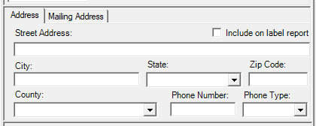
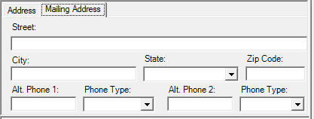
Client Addresses
Demographics tab in CAREWare includes physical & mailing addresses. Complete all fields as much as possible.

Slide 12
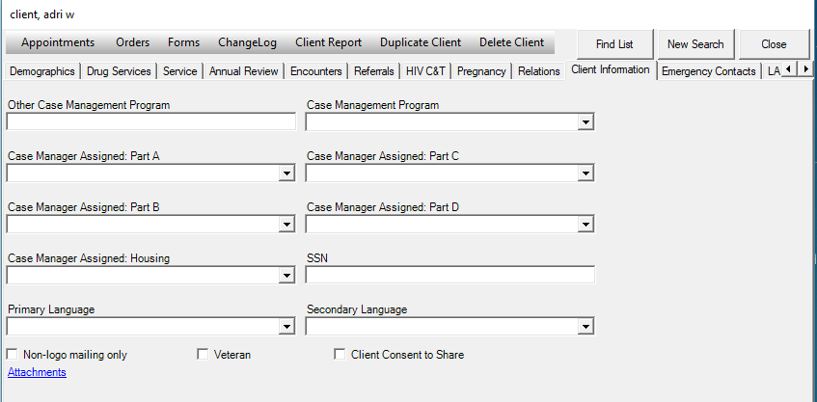
Client Information Tab
Updated to include housing case manager & mailing address will be removed.

Slide 13
Service-Specific Data Entry

Slide 14
All staff should know where to find the most updated information

Slide 15
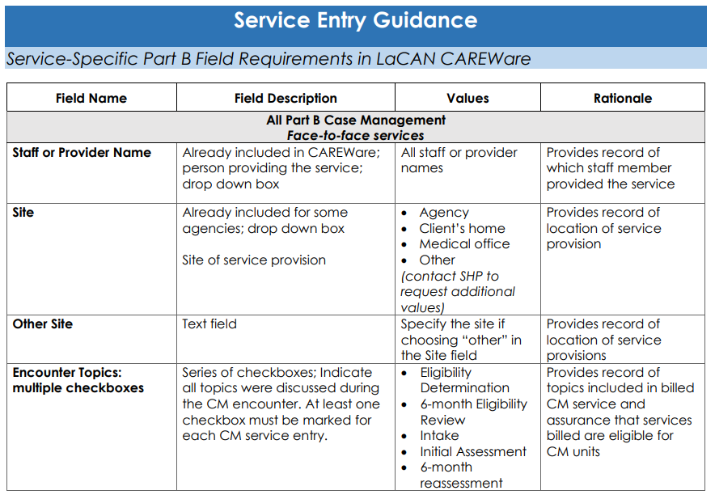
All case managers & data entry staff should have this document
All service-specific required fields for all services will be included when contract negotiations are complete

Slide 16
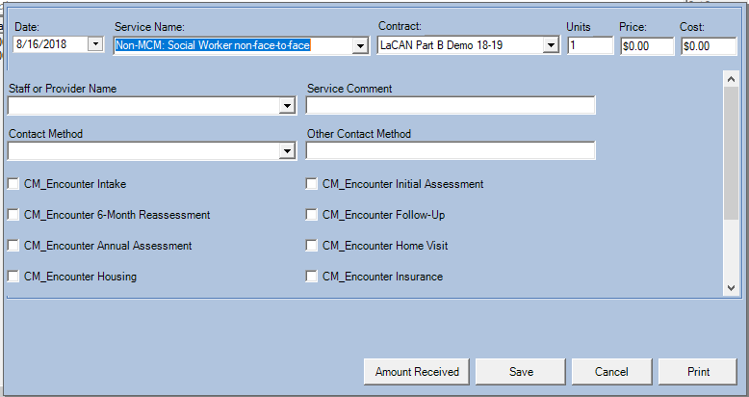
Non-Medical Case Management
Follow the definitions for encounter topics provided in guidance
Check encounter topics per service when needed
At least one encounter topic per Non-MCM entry is required

Slide 17
Referral for Health Care & Supportive Services
Referrals included in funded Part B category “Referral for Health Care & Supportive Services” must be entered as a service on the Services tab in CAREWare
These do not need to be entered on the Referrals tab
Service should be entered within 2 business days of making the referral
Same service entry should be updated when follow-up is complete

Slide 18
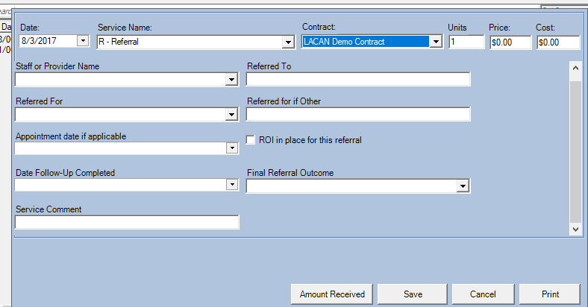
Referral for Health Care & Supportive Services
Refer to service entry guidance for field definitions & examples
Leave these fields blank until referral is closed out:
Date follow-up completed
Final referral outcome

Slide 19
Routine Data Reporting Expectations

Slide 20
Case managers should have access to and know how to run reports for:
Current eligibility status
Upcoming eligibility expiration
Expired eligibility status
Case load
Service history
Full reporting packet will be published & webinar will be held in September 2018.

Slide 21
RW/HOPWA Data Management Technical Assistance
Check Louisianahealthhub.org/support-services
Ask your Case Management Supervisor
Email Rebekah Puebla or Megan Wright Rebekah.Puebla@la.gov
Megan.Wright@la.gov
Notes:
Peer networks

Slide 22
Contact info: Megan Wright Megan.Wright@La.gov 504-568-7526

